Slide 1
SEWB
End-Of-Year Guideline

Slide 2


SEWB Unit Planning, Assessment, & Reporting
It is part of SACSCOC Accreditation & good business practice.
2
An annual/on-going process by which units set, measure, implement, and assess goals.
3
Must be in-line with Institute Strategic Plan (ISP) or President’s Goals (PG).
4
Required for most units: Strategic Assessment Plans (SPA), End-of-Year (EOY), Progress Check-Ins & Reporting.
5
Annual unit reports due on October 1st each year to document goal attainment & accomplishments.
6
Basic Standards for reporting and all SEWB reports due in the Anthology Planning platform
Notes:
Southern Association of Colleges and Schools Commission on Colleges

Slide 3
Units Required to Submit Reports
Arts, Belonging &
Community
SEWB
Vice President
Campus Services
Student Life
Intercultural Student Programs
Office of the Arts
Student & Campus Event Center
Veteran’s Resource Center
Campus Recreation Center
Campus Services Administration
Card Services & Credentialing
Auxiliary Operations
Tech Dining
Housing & Residence Life
Stamps Health Services
Sustainability
Center for Mental Health Care & Resources
Center for Student Engagement
Dean of Students
Leadership Education & Development
Orientation & Transition Programs
Student Integrity
Wellness Empowerment Center
Cultivate Well-Being Action & Transformation
Development and Parent Giving
Marketing & Communications
End-Of-Year Report Only
Budget & Finance, Business Operations, Capital Projects, Engagement and Human Resources/Business Partners.

Slide 4
Strategic Plan Assessment Timeline
Progress Check-In
Progress Check-In
Progress Check-In
July
August
Sept
Oct
Nov
Dec
Jan
Feb
March
April
May
June
Unit Strategic Plan REPORT & EOY
Due October 1st
Unit Strategic PLAN
April 1st
FY Ends June 30th
FY Begins July 1st
ISP Status Update Due
July 1st
ISP Status Update Due
January 8th
PG Update #1
PG Update #2
ISP Status Update Due
April 1st
PG Final Update Due
May 1st
PG= Presidential Goals
ISP= Institute Strategic Plan

Slide 5

End of Year Report

Slide 6

End of Year Report – Accomplishments
In a strategic plan, accomplishments refer to the significant achievements or milestones that an organization or unit has successfully reached as a result of implementing the strategies and actions outlined in the plan. These accomplishments are the tangible outcomes that demonstrate progress toward the strategic objectives and goals. They often include completed projects, improved metrics, successful initiatives, or any other outcomes that align with the strategic vision and contribute to the organization’s overall success.

Slide 7
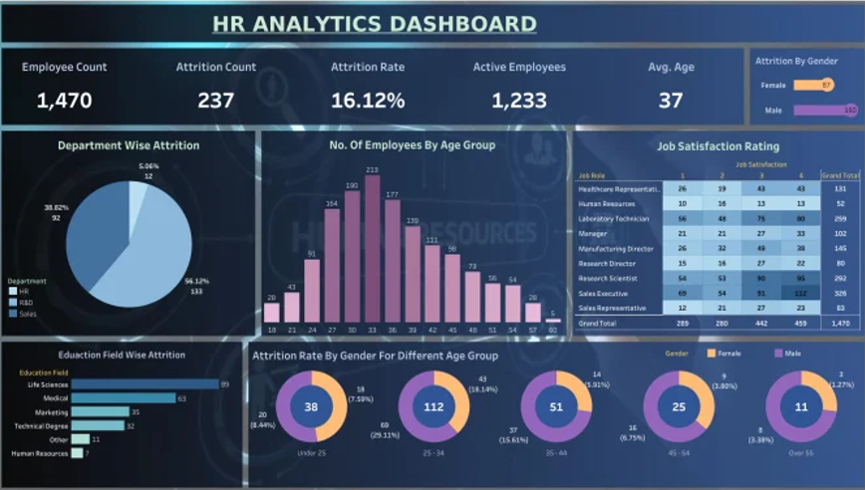


End of Year Report - Supporting Data & Impact
Supporting data refers to the information, statistics, or evidence used to substantiate, validate, or provide context to the accomplishments. Please, provide data to support the listed accomplishments, including charts, graphs, tables, or other visual representations. You may also upload relevant data files.
Impact refers to the significant and measurable effects or outcomes that result from an action, decision, project, or strategy. Please, describe how the accomplishments have positively and measurably impacted student engagement, well-being, access, the closing of equity gaps, or other student-oriented outcomes. Include specific examples or data where possible to illustrate these impacts.

Slide 8



Questions
Dr. Brenda “B” Woods
Office of Research and Assessment
Director
drbwoods@gatech.edu
Rafael Soares
Office of Research and Assessment
Senior Business Analyst
rsoares30@gatech.edu

