Slide 1
AlcoholEdu for College
Georgia Institute of Technology
Impact Report | 2022–2023 Academic Year

Slide 2

Dear Georgia Institute of Technology Partner,
I am pleased to provide your 2022-2023 Impact Report for AlcoholEdu for College. This year’s report includes key insights from your Vector Solutions program, demonstrating the impact of your investment in the health, safety, and well-being of your students and employees.
Prevention efforts have always been central to the mission of higher education. However, emerging insights elevate and reposition this important work in the evolving context of our industry and the communities we serve.
In a recent Vector Solutions survey of current college students, safety, well-being, and inclusion were as important as reputation, academic rigor, and affordability in their decision of which college to attend. Similarly, student well-being initiatives were more strongly correlated with college satisfaction than any other factor, including cost, rigor, and academic opportunity.
Data from Vector Solutions’ campus climate survey showed that students who participated in prevention programs were 50% more likely to feel valued in the classroom, happy to be at their school, and a greater sense of belonging versus students who did not participate in these programs.
Institutions that are maximizing their use of digital prevention programs have, on average, a 10% higher first-year retention rate compared to institutions that are not achieving similar standards.* Over one-third of graduating high school seniors said they’re more likely to attend these leading prevention institutions.
Prevention programming is also fostering the development of critical skills for supporting students in their lives after college. Two-thirds of students who participated in Vector Solutions’ prevention programs said that the course made them feel better prepared and qualified for future jobs. Over 70% felt they had better understanding and awareness of the wider world.
As you delve into the insights in this year’s Impact Report, I encourage you to consider the many ways our work together drives outcomes that not only enhance the well-being of your community but also the performance of your institution. These strategic connections demonstrate that prevention is both mission- and business-critical for the future of higher education.
And working together, that future is abundantly bright.
Rob Buelow
Head of Product, Education
Vector Solutions
* These data are based on the 2022 recipients of the Campus Prevention Network Seal of Prevention.

Slide 3
Table of Contents
How to Use This Report | 4
Executive Summary | 5
Impact Snapshot | 6
AlcoholEdu and Your Students | 10
Course Impact | 11
Behavioral Intentions | 12
Alcohol on Your Campus | 13
College Effect | 14
Examination of Drinking Rates | 15
Drinking Rates, by Gender Identity | 16
When Students Choose to Drink | 17
Where Students Choose to Drink | 18
Why Students Choose to Drink | 19
Why Students Choose Not to Drink | 20
High-Risk Drinking Behaviors | 21
Impact of High-Risk Drinking | 22
Engaging Your Students | 23
Appendix – Student Demographics | 24
Supplemental Information | 27
Prevention Framework | 28
About AlcoholEdu for College | 29
AlcoholEdu for College Course Map | 30
Report References and Resource Links | 31

Slide 4

How To Use This Report
Peer Institution Benchmarks
Campus Prevention Network Framework Tips
Throughout this report, select data from your institution is benchmarked against aggregate data from peer institutions. These peer institutions are similar to yours in size, and public or private status. Georgia Institute of Technology is a large public institution, so your benchmarks reflect other public schools with 20,000 or more students.
The Campus Prevention Network Framework for Prevention describes the elements of effective prevention efforts: Institutionalization, Critical Processes, Policy, and Programming. Throughout this report, you will find Tips and further research related to these prevention elements.
This report provides key insights from your AlcoholEdu for College data. We encourage you to explore the data in the report, think about how you can use it to inform prevention efforts across your institution, and share it with others on your campus.
To help you make the most of this report, we have included benchmarks to help you understand where you stand relative to peer institutions, provided recommendations throughout the report tied to a framework for prevention, and included a sharable snapshot of your data at the end of this report.
For deeper insights, the administrator site provides real-time access to your Vector Solutions data, in both graphical and raw data formats.
About the Data in This Report
Type of Data
This report includes data from several student surveys: pre-course surveys taken immediately before the course; post-course surveys taken immediately after the course is completed; and follow-up surveys taken after an intersession period - typically four-to-six weeks - following course completion. Only data from students who responded to all three AlcoholEdu surveys are included in this report.
(n = 2,421).
Data Accuracy
Our analysis of the responses found the data to be accurate, valid, and reliable. There is great consistency in the data from student cohorts over the years at specific institutions and our survey data correlates with external sources of information on substance misuse at the national and institutional level for college students.
Important Note About Your 2022-2023 Data
The data included in this report were collected on the Foundry platform between June 1, 2022 and January 26, 2023. While learners are encouraged to answer all questions honestly and are notified that their responses are stored confidentially, they are reminded that all survey questions are optional. This year’s surveys emphasized the ability of learners to opt out of any or all survey questions. Thus, some schools may have experienced lower response rates than in previous years for the follow-up survey. Because AlcoholEdu data includes only the responses from students who completed all three surveys, a small respondent sample size for the follow-up survey is likely to impact some of the data displayed in this report.

Slide 5
Executive Summary
This school year,
2,421 Georgia Institute of Technology students have completed all three AlcoholEdu for College course surveys since the start of the 2022-2023 academic year. This course, developed by prevention education and compliance experts, uses relatable scenarios and interactive elements to provide students with alcohol information, strategies for healthy behavior, and skills to support bystander intervention.
Course Impact
AlcoholEdu is designed to equip your students with knowledge and skills to support healthier decisions related to alcohol.
When it comes to skills, 99% of your students agree that AlcoholEdu helped them establish a plan ahead of time to make responsible decisions about drinking, and 99% report that the education prepared them to help someone who may have alcohol poisoning.
Behavioral Intentions & Norms
Intention is a key variable in predicting behavior change. Change is driven, in part, by an individual’s perception of the social environment surrounding behavior — the community norms.
Nationally, more students are choosing to regularly abstain from alcohol. At your school, 68% of students surveyed are abstainers and 20% are nondrinkers. Many perceive that their peers are drinking more than they are, and may feel alienated by that perception.
Among students at Georgia Institute of Technology who took AlcoholEdu, 83% agreed that the course changed their perceptions of others’ drinking behavior. And a substantial number of your students after taking the course report that they intend to limit their drinking frequency (67%) or the number of drinks they consume (65%).
Drinking Motivation
At Georgia Institute of Technology, the top reason students choose to drink is “To have a good time with friends” (87% of drinkers). Among nondrinkers, 95% say they don’t drink because “Drinking is against my personal values” -- 3% of drinkers cite the same reason when they choose not to drink.
Your AlcoholEdu for College Impact Report includes detailed information about when, where, and why your students drink — and why they don’t. This data can be invaluable in guiding your prevention programming for maximum impact.

Slide 6
AlcoholEdu for College
Impact Snapshot

Slide 7

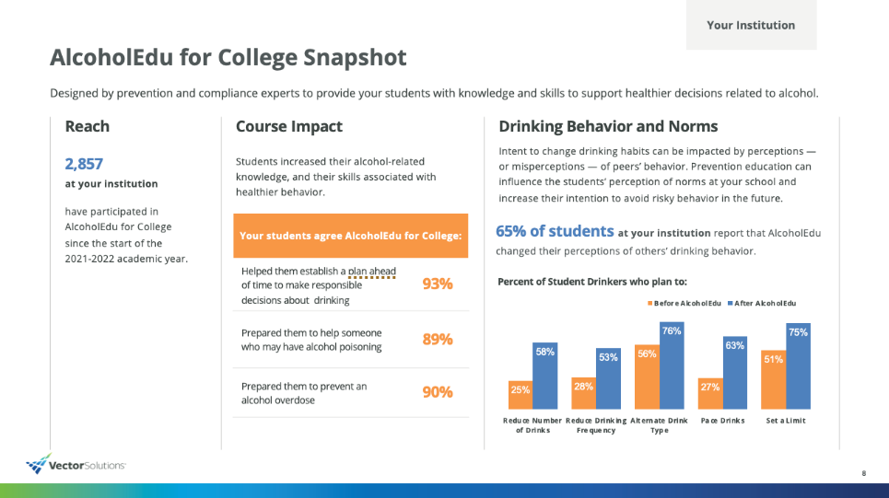
Impact Snapshot
In order to make the content of this report easier to share with your colleagues and stakeholders, we have included a Snapshot section that highlights and visually displays the most salient data points from the full report.
This take-away can help your data get more traction and increase interest in the full report, as well as the AlcoholEdu for College program at large.
We recommend excerpting the Snapshot section from the full report and sharing with stakeholders, colleagues, and students who might be interested in the impact of the AlcoholEdu for College program but have less direct experience in substance abuse prevention work.

Slide 8
AlcoholEdu for College Snapshot
Georgia Institute of Technology
Designed by prevention and compliance experts to provide your students with knowledge and skills to support healthier decisions related to alcohol.
Reach
Course Impact
Drinking Behavior and Norms
2,421 students
at Georgia Institute of Technology
students have completed all three AlcoholEdu for College course surveys since the start of the 2022-2023 academic year.
Intent to change drinking habits can be impacted by perceptions — or misperceptions — of peers’ behavior. Prevention education can influence the students’ perception of norms at your school and increase their intention to avoid risky behavior in the future.
Students increased their alcohol-related knowledge, and their skills associated with healthier behavior.
Your students agree AlcoholEdu for College:
Helped them establish a plan ahead of time to make responsible decisions about drinking | 99%
Prepared them to help someone who may have alcohol poisoning | 99%
Prepared them to prevent an alcohol overdose | 98%
83% of students at Georgia Institute of Technology report that AlcoholEdu changed their perceptions of others’ drinking behavior.
Percent of Student Drinkers who plan to:
Notes:
Variables:
|reduce_number_s1|
|reduce_number_s3|
|reduce_frequency_s1|
|reduce_frequency_s3|
|alt_drink_s1|
|alt_drink_s3|
|pace_drink_s1|
|pace_drink_s3|
|set_limit_s1|
|set_limit_s3|

Slide 9
AlcoholEdu for College Snapshot
Georgia Institute of Technology
When
Tip
The data shown here reflect the 21-day period where institutions tend to report the highest drinking rates. Can these data be used to reinforce or support other data you have collected to identify celebrations or events that encourage or discourage heavy drinking?
AlcoholEdu for College provides you with a wealth of information on your students’ drinking habits: When, Where, Why (and Why Not) they are drinking.
Georgia Institute of Technology can use this information to inform prevention program content,
audience, and delivery.
Where
40% | 14% | 11% | 10% | 7% | 6%
Fraternity/sorority house | Off campus residence | At home | On campus residence | Bar or night club | Athletic event
Top Reasons
Why
Why Not
Tip
“It would be far easier to increase the salience of existing reasons that drinkers have for restricting their alcohol use than to win their endorsement of still additional reasons that are primarily endorsed by abstainers (Huang et al., 2011).” Which reasons are most endorsed by drinkers on your campus? By non-drinkers? Consider those when designing campaigns focused on behavioral decision making for each of these groups of students.
Students Choose To Drink (drinkers only)
Why Students Choose NOT To Drink (abstainers and drinkers)
Notes:
When
|10/17_y|
|10/17_p|
|10/18_y|
|10/18_p|
|10/19_y|
|10/19_p|
|10/20_y|
|10/20_p|
|10/21_y|
|10/21_p|
|10/22_y|
|10/22_p|
|10/23_y|
|10/23_p|
|10/24_y|
|10/24_p|
|10/25_y|
|10/25_p|
|10/26_y|
|10/26_p|
|10/27_y|
|10/27_p|
|10/28_y|
|10/28_p|
|10/29_y|
|10/29_p|
|10/30_y|
|10/30_p|
|10/31_y|
|10/31_p|
|11/1_y|
|11/1_p|
|11/2_y|
|11/2_p|
|11/3_y|
|11/3_p|
|11/4_y|
|11/4_p|
|11/5_y|
|11/5_p|
|11/6_y|
|11/6_p|
>>>>>>>>>>>>>>>>>>>>>
slide9Why
|s_drink1|
|s_drink2|
|s_drink3|
|s_drink4|
|p_drink1|
|bp_drink1|
|p_drink2|
|bp_drink2|
|p_drink3|
|bp_drink3|
|p_drink4|
|bp_drink4|
>>>>>>>>>>>>>>>>
slide9WhyNot
|s_wnd1|
|s_wnd2|
|s_wnd3|
|s_wnd4|
|wnd1_nd|
|wnd1_d|
|wnd2_nd|
|wnd2_d|
|wnd3_nd|
|wnd3_d|
|wnd4_nd|
|wnd4_d|

Slide 10
AlcoholEdu and Your Students
Impact at Georgia Institute of Technology

Slide 11
Course Impact
Knowledge Gain
Learner Impact
Your students reported that AlcoholEdu for College: (From post-course survey)
Prepared them to prevent an alcohol overdose | 98%
Prepared them to help someone who may have alcohol poisoning | 99%
Helped them establish a plan ahead of time to make responsible decisions about drinking | 99%
Changed their perceptions of others’ drinking behavior | 83%
Programming Tip
Where are your students knowledgeable and where is there room to learn more? AlcoholEdu is intended to provide foundational knowledge and skills that can be built upon. Knowledge data can inform which content areas should be built out or reinforced as part of your ongoing prevention efforts.
Notes:
Variables:
|preAK|
|postAK|
|prePE|
|postPE|
|preRR|
|postRR|
|preUI|
|postUI|
|preFI|
|postFI|

Slide 12
Behavioral Intentions
Impact For High-Risk Students
69 high-risk drinkers completing AlcoholEdu for College saw "no need to change the way they drink" before taking the course. Following the course, 78% of those students (54 students) reported a readiness to change their drinking behavior.
Note:
Readiness to change represents the collective share of students who selected one of the following:
I am thinking about drinking alcohol in a healthier and safer way.
I am ready to try drinking alcohol in a healthier and safer way.
I am currently trying to drink alcohol in a healthier and safer way.
Institutionalization Tip
Intention has been shown to be the most important variable in predicting behavior change (Ajzen, 1991). Actual behavior change is driven, in part, by an individual’s perception of the social environment surrounding the behavior. A campus environment that reinforces safe and healthy norms can help support individual intentions and, ultimately, changes in behavior. Where unhealthy behaviors are perceived as accepted and even encouraged, intentions may not be sufficient to support change. Did your students report an increase in healthy intentions, or a decrease? What environmental factors on your campus may have contributed to shifts in either direction?
Notes:
Variables:
|reduce_number_s1|
|reduce_number_s3|
|reduce_frequency_s1|
|reduce_frequency_s3|
|alt_drink_s1|
|alt_drink_s3|
|pace_drink_s1|
|pace_drink_s3|
|set_limit_s1|
|set_limit_s3|

Slide 13
Alcohol On Your Campus
Data and insights from students at Georgia Institute of Technology

Slide 14
College Effect
Nationally, student drinking rates follow a pattern: Alcohol use generally rises over the summer before students enter college, then increases substantially after their arrival on campus.
Institutions have a narrow window of opportunity for primary prevention. Through evidence-based education and prevention efforts, including AlcoholEdu for College, institutions can mitigate the impact of the College Effect.
To be most effective, these primary prevention efforts should address all students, not just those with a prior history of heavy or problematic drinking. Institutions should not overlook efforts to reinforce the behaviors of the healthy majority.
Summer Before College
Fall Semester
Drinking rates increase at a much higher rate with limited or no prevention efforts in place
Drinking Rate
Without Prevention
With Prevention
Drinking rates are mitigated with prevention efforts in place
Classes Start
Programming Tip
Consider shifts in behavior that you see between pre- and post-course surveys within the context of the College Effect. This phenomenon will exist to a lesser or greater degree on your campus, depending on specific environmental and cultural influences, but in many cases, primary prevention efforts can be used to lessen the impact of the College Effect.

Slide 15
Examination of Drinking Rates
Relative Change
Survey 1 to Survey 3
Considering the College Effect, here is how your students (n = 278) reported their drinking rates on pre- and post-course surveys (separated by four-to-six weeks).
Category | Your Institution | Peer Institutions
Abstainer | -5% | -2%
Nondrinker | -5% | -10%
Moderate Drinker | 34% | 14%
Heavy Episodic Drinker | 40% | 22%
Problematic Drinker | 24% | 26%
Drinking categories include:
Abstainer
Consumed no alcohol in the past year.
Nondrinker
Consumed no alcohol in the past two weeks but may have consumed in the past year.
Programming Tip
How did your students’ drinking behavior change in the four-to-six weeks between these surveys? Keep in mind that even small percentage changes can reflect significant differences, especially for low-frequency behaviors like problematic drinking. Look at how you compare to similar institutions and think about how you can use this information to inform student programming. For example, a relative drop in the share of abstainers could indicate a need for programming to support incoming abstaining students.
Moderate Drinker
On their highest drinking day in the prior two weeks, consumed 1-4 drinks (males) or 1-3 drinks (females)
Heavy Episodic Drinker
On their highest drinking day in the prior two weeks, consumed 5-9 drinks (males) or 4-7 drinks (females)
Problematic Drinker
On their highest drinking day in the prior two weeks, consumed 10+ drinks (males) or 8+ drinks (females)
Notes:
Variables for graph:
|abstainer_s1|
|abstainer_s3|
|nondrinker_s1|
|nondrinker_s3|
|moderate_s1|
|moderate_s3|
|heavy_s1|
|heavy_s3|
|problem_s1|
|problem_s3|

Slide 16
Drinking Rates By Gender Identity
Men and women often follow different drinking patterns and may experience the College Effect differently. Here are your students’ drinking categories at the follow up survey (n = 278), broken down by gender identity.
Note
In the context of drinking rates, male and female students are identified by their self-reported biological birth sex, as biological sex influences how individuals metabolize alcohol and is used to determine their drinking behavior categories. Vector Solutions recognizes and appreciates that learners’ gender identity may not be the same as their biological birth sex and communicates that throughout the course.
While this report presents comparisons only between students who identify as male or female— they are the most researched populations regarding personal alcohol use and related behaviors — students can select additional gender identities or choose not to identify their gender.
Critical Processes Tip
Notice how drinking behaviors may be different for male and female students. Think about what other demographic characteristics may have an influence on drinking behavior at your institution, including race, ethnicity, group membership, year in school, etc. This may inform how different subgroups of students are experiencing the College Effect and where supplemental resources will be necessary.
Notes:
Variables:
|s3_abs_m|
|s3_abs_f|
|s3_nondrink_m|
|s3_nondrink_f|
|s3_moderate_m|
|s3_moderate_f|
|s3_heavy_m|
|s3_heavy_f|
|s3_problematic_m|
|s3_problematic_f|

Slide 17
When Students Choose To Drink
The chart on this page shows student drinking rates over a two-week period of time. It represents the average number of drinks consumed by your students (drinkers only), compared to the average drinks consumed at peer institutions during that same three-week period.
Follow-Up Survey, drinkers only, n = 278
Critical Processes Tip
The data shown here reflect the 21-day period where institutions tend to report the highest drinking rates. Can these data be used to reinforce or support other data you have collected to identify celebrations or events that encourage or discourage heavy drinking?
Notes:
When
|10/17_y|
|10/17_p|
|10/18_y|
|10/18_p|
|10/19_y|
|10/19_p|
|10/20_y|
|10/20_p|
|10/21_y|
|10/21_p|
|10/22_y|
|10/22_p|
|10/23_y|
|10/23_p|
|10/24_y|
|10/24_p|
|10/25_y|
|10/25_p|
|10/26_y|
|10/26_p|
|10/27_y|
|10/27_p|
|10/28_y|
|10/28_p|
|10/29_y|
|10/29_p|
|10/30_y|
|10/30_p|
|10/31_y|
|10/31_p|
|11/1_y|
|11/1_p|
|11/2_y|
|11/2_p|
|11/3_y|
|11/3_p|
|11/4_y|
|11/4_p|
|11/5_y|
|11/5_p|
|11/6_y|
|11/6_p|

Slide 18
Where Students Choose To Drink
The most common locations where your students reported consuming alcohol recently, among those who had a drink in the previous two weeks.
Follow-Up Survey (Survey 3), drinkers only, n = 278
Policy Tip
Certain drinking locations — including campus pubs, off-campus house parties — have been shown to be associated with significant negative outcomes (EVERFI, 2012). The same study also indicated that certain locations (on-campus dances and concerts) have a greater relationship with sexual assault than other locations.
A more recent study found students living off-campus (without parents) report significantly more frequent alcohol consumption, drinking larger quantities, more frequent heavy drinking, and a greater number of negative alcohol-related outcomes than students living on-campus (Benz et al., 2017).
How can this research and drinking location data from your school inform housing and on-campus policy at your institution?
Notes:
Variables:
|on_campus_residence|
|off_campus_residence|
|frat_soror|
|athletic_event|
|bar_nightclub|
|outdoor_setting|
|restaurant|
|in_a_car|
|at_home|
|none_of_these|

Slide 19
Why Students Choose To Drink
Drinkers indicated their most important reasons for choosing to drink alcohol.
Follow-Up Survey (Survey 3), drinkers only, n = 278
Programming Tip
Reasons for consuming alcohol vary greatly for institutions and across different groups of students. Consider the reasons why students are choosing to drink and investigate whether those challenges can be met with other strategies for these students.
With your data, you can also explore whether certain reasons for drinking are associated with higher-risk drinking behaviors and negative outcomes. These reasons could be candidates to target with social norm campaigns or other prevention efforts.
Notes:
Why
|drink1|
|drink2|
|drink3|
|drink4|
|p_drink1|
|bp_drink1|
|p_drink2|
|bp_drink2|
|p_drink3|
|bp_drink3|
|p_drink4|
|bp_drink4|

Slide 20
Why Students Choose Not To Drink
Both drinkers and nondrinkers indicated their most important reasons for choosing whether or not to drink alcohol.
Follow-Up Survey (Survey 3), nondrinkers, n = 1,480 and drinkers, n = 278
Programming Tip
“It would be far easier to increase the salience of existing reasons that drinkers have for restricting their alcohol use than to win their endorsement of still additional reasons that are primarily endorsed by abstainers (Huang et al., 2011).” Which reasons are most endorsed by drinkers on your campus? By nondrinkers? Consider those when designing campaigns focused on behavioral decision making for each of these groups of students.
Notes:
WhyNot
|wnd1|
|wnd2|
|wnd3|
|wnd4|
|wnd1_nd|
|wnd1_d|
|wnd2_nd|
|wnd2_d|
|wnd3_nd|
|wnd3_d|
|wnd4_nd|
|wnd4_d|

Slide 21
High-Risk Drinking Behaviors
These are some of the most common risk-related drinking behaviors reported by your students who had a drink in the two weeks prior to survey.
Follow-Up Survey (Survey 3), drinkers only, n = 278
Programming Tip
More than other high-risk behaviors, pregaming has been shown to have a predictive relationship with a variety of negative outcomes (EVERFI, 2012). As such, participation in pregaming can potentially be used to identify students who are more likely to be at risk for experiencing negative outcomes.
Notes:
Variables: 4/2/22 note make sure to update Windward variables, removed dynamic variables, hardcoded 3 HR behaviors
|hr1_m|
|hr1_f|
|hr2_m|
|hr2_f|
|hr3_m|
|hr3_f|

Slide 22
Impact of High-Risk Drinking
Students who reported drinking in the past two weeks experienced the following as a result of their drinking.
Follow-Up Survey (Survey 3), drinkers only, n = 278
Programming Tip
The AlcoholEdu Facilitator Guide provides recommendations for campus programs that reinforce course content. It includes sample discussion topics and activities designed for use by trained facilitators, including ways to reduce the risk of experiencing negative outcomes.
Notes:
Impact
|outcome1|
|outcome2|
|outcome3|
|outcome4|
|out1|
|b_out1|
|out2|
|b_out2|
|out3|
|b_out3|
|out4|
|b_out4|

Slide 23

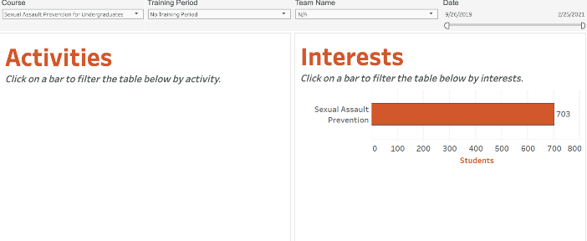
Engaging Your Students
Effective prevention includes actively engaging students to reinforce positive behavioral intentions of all students: drinkers and nondrinkers alike.
A growing number of students arriving on campus choose to regularly abstain from alcohol use. Research has shown that these students are more likely to be successful in their commitment to not drink if they are able to connect with like-minded peers. AlcoholEdu for College provides campuses with a unique tool to identify and assist students with that process. Students can opt in to be contacted by your institution about connecting with peers who are interested in a social life that isn't focused on alcohol.
AlcoholEdu for College also enables students to indicate their interest in learning more about a school’s programs and services to support recovery from alcohol or other substance use disorders. Whether seeking information for themselves, a friend, or a family member, students may opt in to be connected with available resources.
Engaging students who are excited to learn and participate more in your prevention efforts and publicizing that collaboration helps to show how most students support a safe community, healthy behavior, and personal responsibility.
Programming Tip
Your students provided their names and email addresses in order to be contacted regarding any or all opportunities, and also indicated which specific types of alcohol-free activities they are most interested in attending. All student lists can be downloaded from the administrator site. We also recommend looking to the AlcoholEdu for College Facilitator Guide as a resource for ways to utilize this student engagement data.

Slide 24
AlcoholEdu for College
Appendix | Student Demographics

Slide 25
Student Demographics
This and the following pages are a summary of the demographics of your students who participated in AlcoholEdu this year. Demographic information is self-reported by students as part of the post-course survey (Survey 2). All questions are optional, and students may choose not to share demographic information.
Notes:
Variables:
|american|
|black|
|white|
|hispanic|
|asian|
|african|
|native|
|other|

Slide 26
Student Demographics (Continued)
Critical Processes Tip
Does this data reflect the overall demographic makeup of your students assigned to take AlcoholEdu? Demographic data can be used to identify underrepresented populations and consider additional data sources needed to identify the impact of substance misuse for these populations.
Additional demographics available to explore include: sexual orientation, age, current residence type, membership in student clubs or activities.
 | Woman | 42% |  | Man | 55%
 | Non-binary | 1% |  | Prefer to self-describe | 0%
 | Prefer not to answer |  | 2%
 | Heterosexual/Straight | 59% |  | Bisexual | 6%
 | Gay | 1% |  | Lesbian | 1%
 | Questioning | 3% |  | Prefer to self-describe | 0%
 | Prefer not to answer | 4%
Do you identify as trans (e.g., transgender, transsexual, a person with transitioning sex or gender history, etc.)?
Yes | 1% | No | 97% | Not sure | 1% | Prefer not to answer | 2%
Notes:
GenderIdentity
|fem|
|mal|
|nbin|
|psdg|
|pna|
>>>>>>>>>>>>>>>>>>>>>>>>
SexualOrientation
|het|
|bis|
|gay|
|les|
|ques|
|psd|
|pna_so|

Slide 27

AlcoholEdu for College
Supplemental Information

Slide 28
The Prevention Framework
Policy
Institutionalization
Critical Processes
Programming
Prevention training, programs and communication strategies that maximize engagement and drive impact
The Prevention Framework, developed by Vector Solutions’ Campus Prevention Network, defines the elements of a comprehensive approach to prevention, and the ways in which those elements build to an effective prevention program.
The values and expectations of
the organization, and the-system of accountability to uphold and enforce them
Using goal setting, strategic planning, and data analysis to inform and evaluate prevention work
System-wide buy-in, visible commitment, and investment in effective prevention initiatives

Slide 29
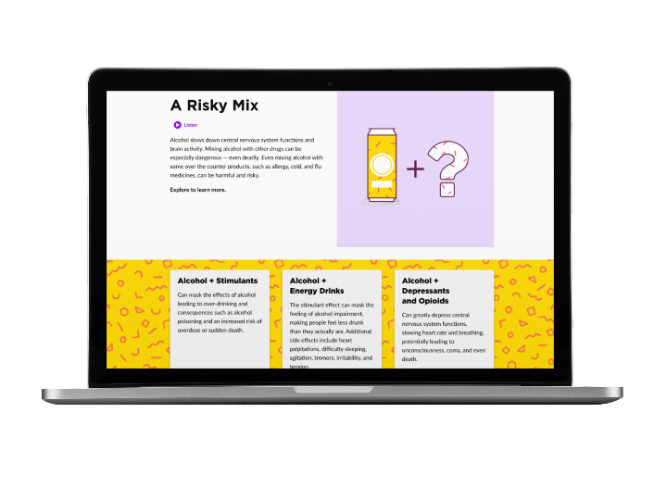
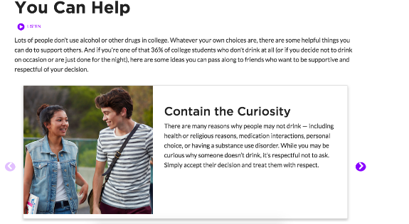
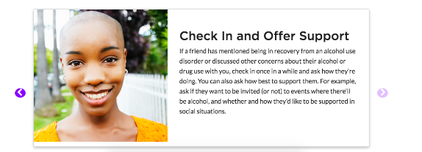
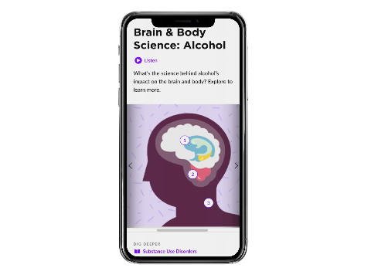
About AlcoholEdu for College
The Benefits of Working with Vector Solutions
AlcoholEdu for College
Proven Efficacy
Nine independent studies have been published demonstrating the efficacy of Vector’s online programs in improving knowledge, attitudes, and behaviors.
Developed in Collaboration
with leading prevention experts and researchers.
Interactive Content
guided by recommendations from the National Institute of Alcohol Abuse and Alcoholism (NIAAA).
True Expertise
Our team includes public health professionals, administrators from student affairs, campus prevention offices, legal experts, and more. Extend your team by partnering with ours.
Informed by Emerging Research
on evidence-based practice (e.g., social norms approach, bystander intervention) and college student behavior
Beyond Compliance
Our online programs are built by prevention and compliance experts to meet and exceed requirements from Title IX, Clery Act, and EDGAR part 86.
Cited as a Top-tier Strategy by NIAAA
in their College Alcohol Intervention Matrix (AIM).
Data Driven
Our data and analytics provide real-time access to attitudinal and behavioral data from your unique populations, and national benchmarks to assess needs and strengths.
Most Widely Used
universal online AOD prevention program since its development in 2000, with over 11M users to date.

Slide 30
AlcoholEdu for College Course Map
Part 1 | 1. Getting Started Introductory Video Custom Welcome Letter Custom Welcome Video | 2. Standard Drink Student Alcohol Knowledge Interviews Pre-Assessment Standard Drink Definition Identifying Standard and Non-Standard Drinks Pouring Standard Drinks | Survey 1 | 3. Where Do You Stand? Risk Factors & Choices You Are Not Alone/Benefits of Not Drinking/Calories & Cash/Support for Your Choice Your Drinking Profile/ Your Peak BAC/Reducing Your BAC/Drinking Consequences/Calories & Cash/Your Drinking Habits
 | 4. Goal Setting What’s Important to You? What Do You Want to Focus on this Year My Choices | 5. Drinking & Motivation What Do You Think? Factors That Can Influence Decisions Why/Why Not Drink? Poll Expectancy Theory & Advertising Ads Appealing to Men/Women Alcohol & Advertising Poll Write a Tagline | 6. Brain & Body BAC Basics What Factors Affect BAC Risk/Protective Factors BAC Calculator Marijuana & Drugs Sexual Assault & Understanding Consent Brain & Body Science Biphasic Effect A BAC Story | 7. My Action Plan Drinker/NonDrinker Plan Choose Your Strategies Activities on Campus
 | 8. Laws & Policies Alcohol Related Laws Campus Policies Drinking & Driving | 9. Helping Friends Taking Care of Yourself & Others Alcohol Poisoning Helping Your Friends Poll Drinking & Driving Getting Help | Survey 2 and Post-Assessment | INTERSESSION
Part 2 | 10. Introduction Welcome Back | Survey 3 | 11. Recognizing Problems Taking Care of Yourself & Others – The Roommate | 12. Course Conclusion Summary of Key Topics Review Goals, Choices and Plan

Slide 31
Report References & Resource Links
Slide
Links
Behavioral Intentions
Ajzen, I. (1991). The theory of planned behavior. Organizational Behavior and Human Decision Processes, 50, 179-211.
The Campus Prevention Network Resource Hub
Please note: these resources are currently being housed on the Vector Solutions website. All materials are relevant to current Campus Prevention Network courses until completion of the upgrade to the Vector Solutions platform.
https://www.vectorsolutions.com/networks/campus-prevention-network/
Where Students Drink
EVERFI analysis of data from AlcoholEdu for College national database, 2012.
Benz, M. B., DiBello, A. M., Balestrieri, S. G., Miller, M. B., Merrill, J. E., Lowery, A. D., ... & Carey, K. B. (2017). Off-campus residence as a risk factor for heavy drinking among college students. Substance use & misuse, 52(9), 1236-1241.
AlcoholEdu for College Facilitator Guide
https://info.vectorsolutions.com/cpn-facilitators-guides
Why Students Choose Not to Drink
Huang, J-H, DeJong W, Schneider SK, & Towvim, LG. (2011). Endorsed reasons for not drinking alcohol: A comparison of college student drinkers and abstainers. Journal of Behavioral Medicine, 34, 64-73.
Join the Campus Prevention Network
https://www.vectorsolutions.com/networks/campus-prevention-network/
High-Risk Drinking Behaviors
EVERFI analysis of data from AlcoholEdu for College national survey database, 2012.
The Role of Alcohol in Sexual Assault
Parkhill, M.R., & Abbey, A. (2008). Does alcohol contribute to the confluence model of sexual assault perpetration? Journal of Social and Clinical Psychology, 27:6, 529-554.

Slide 32



