Slide 1
Mental Well-Being for Students
Georgia Institute of Technology
Impact Report | 2022–2023 Academic Year

Slide 2

Dear Georgia Institute of Technology Partner,
I am pleased to provide your 2022-2023 Impact Report for Mental Well-Being for Students. This year’s report includes key insights from your Vector Solutions program, demonstrating the impact of your investment in the health, safety, and well-being of your students and employees.
Prevention efforts have always been central to the mission of higher education. However, emerging insights elevate and reposition this important work in the evolving context of our industry and the communities we serve.
In a recent Vector Solutions survey of current college students, safety, well-being, and inclusion were as important as reputation, academic rigor, and affordability in their decision of which college to attend. Similarly, student well-being initiatives were more strongly correlated with college satisfaction than any other factor, including cost, rigor, and academic opportunity.
Data from Vector Solutions’ campus climate survey showed that students who participated in prevention programs were 50% more likely to feel valued in the classroom, happy to be at their school, and a greater sense of belonging versus students who did not participate in these programs.
Institutions that are maximizing their use of digital prevention programs have, on average, a 10% higher first-year retention rate compared to institutions that are not achieving similar standards.* Over one-third of graduating high school seniors said they’re more likely to attend these leading prevention institutions.
Prevention programming is also fostering the development of critical skills for supporting students in their lives after college. Two-thirds of students who participated in Vector Solutions’ prevention programs said that the course made them feel better prepared and qualified for future jobs. Over 70% felt they had better understanding and awareness of the wider world.
As you delve into the insights in this year’s Impact Report, I encourage you to consider the many ways our work together drives outcomes that not only enhance the well-being of your community but also the performance of your institution. These strategic connections demonstrate that prevention is both mission- and business-critical for the future of higher education.
And working together, that future is abundantly bright.
Rob Buelow
Head of Product, Education
Vector Solutions
* These data are based on the 2022 recipients of the Campus Prevention Network Seal of Prevention.

Slide 3
Table of Contents
How to Use This Report | 4
Executive Summary | 5
Impact Snapshot | 6
Mental Well-Being for Students and Your Students | 10
Seeking Help and Support for Mental Health | 11
Supporting Others in the Community | 12
Mental Well-Being on Your Campus | 13
A Continuum of Student Mental Health | 14
Social Norms for Behavior | 15
Proactive Bystander Behaviors | 16
Barriers to Accessing Care | 17
Campus Climate | 18
Community Readiness | 19
Appendix – Student Demographics | 20
Supplemental Information | 23
Prevention Framework | 24
About Mental Well-Being for Students | 25

Slide 4

How To Use
This Report
Peer Institution Benchmarks
Campus Prevention
Network Framework Tips
Sharable Snapshot
For select data points in this report, you will see comparisons to peer institution benchmarks. These peer institutions are similar to you in size, and public or private status. Georgia Institute of Technology is a large public institution, so your benchmarks reflect other public schools with 20,000 or more students.
The Campus Prevention Network Framework for Prevention describes the elements of effective wellness and prevention efforts: Institutionalization, Critical Processes, Policy, and Programming. Throughout this report, you will find Tips and further research related to these prevention elements.
At the end of this report, you will find a snapshot of select data from your report. This snapshot is designed to be shared with other stakeholders at your institution. We hope that you will print these pages out and pass them along to your Vice President of Student Affairs, Provost, or other members of your team.
This report provides key insights from your Mental Well-Being for Students data. We encourage you to explore the data in the report, think about how you can use it to inform prevention efforts across your institution, and share it with others on your campus.
To help you make the most of this report, we have included benchmarks to help you understand where you stand relative to peer institutions, provided recommendations throughout the report tied to a framework for prevention, and included a sharable snapshot of your data at the end of this report.
For deeper insights, the administrator site provides real-time access to your data, in both graphical and raw data formats.
Data in this Report
Data Accuracy
The data included in this report were collected on the Foundry platform between June 1, 2022 and January 26, 2023. Insights and analyses in this report are based on your students' responses to pre-course and post-course surveys. Overall, 2,898 students completed pre-course surveys, and 2,936 completed post-course surveys.
While learners are encouraged to answer all questions honestly and reminded that their responses are stored confidentially, all survey questions are optional and all data are self-reported. However, in our analysis of the responses, we find the data to be accurate, valid, and reliable. There is consistency in the data from student cohorts over the years at specific institutions, and our survey data correlates with external sources of information on these topic areas at the national and institutional level for college students.

Slide 5
Executive
Summary
This school year,
3,575 Georgia Institute of Technology students took part in Mental Well-Being for Students. This course, developed by prevention education and compliance experts, uses relatable scenarios and interactive elements to provide students with strategies for healthy behavior and skills to support bystander intervention.
Course Impact
Mental Well-Being for Students is designed to equip your students with knowledge and skills to support their own and their peers’ mental well-being, and to access support when needed.
Georgia Institute of Technology students increased their knowledge of topics related to mental well-being by 3%. When it comes to skills, after completing Mental Well-Being for Students, 68% of students say they would know how to access help if they needed it and 68% of students agree that they are responsible to help if a classmate is struggling.
Behavioral Intentions & Norms
Change is driven, in part, by an individual’s perception of the social environment surrounding behavior — the community norms.
Most students taking this course report healthy, desirable attitudes and behaviors related to mental well-being, their ability to manage challenging situations, and the desirability of seeking help. This includes 91% of students who believe it is healthy to discuss mental health concerns and 92% who would support someone else who was seeking help for mental health reasons.
Among students at Georgia Institute of Technology who took Mental Well-Being for Students, 20% are currently involved, or plan to get involved, in efforts to support mental health on their campus. And though students do, at times, encounter barriers when accessing help, 62% of students agree that students’ mental and emotional well-being is a priority at your school.
Your Mental Well-Being for Students Impact Report includes detailed information about how your students think, feel, and behave regarding mental well-being. This data can be invaluable in guiding your programming for maximum impact.

Slide 6
Mental Well-Being for Students
Impact Snapshot

Slide 7

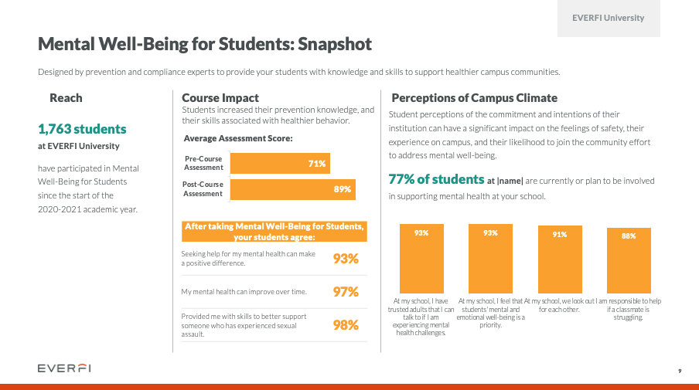
Impact Snapshot
In order to make the content of this report easier
to share with your colleagues and stakeholders,
we have included a Snapshot section that highlights and visually displays the most salient data points from the full report.
This can help your data get more traction and increase interest in the full report and the Mental Well-Being for Students program at large.
We recommend excerpting this Snapshot section from the full report and sharing with stakeholders, colleagues, and students who might be interested in the impact of the Mental Well-Being for Students program but have less direct experience in prevention work.

Slide 8
Mental Well-Being for Students: Snapshot
Georgia Institute of Technology
Designed by prevention and compliance experts to provide your students with knowledge and skills to support healthier campus communities.
Reach
Course Impact
Students increased their prevention knowledge, and their skills associated with healthier behavior.
Perceptions of Campus Climate
Student perceptions of the commitment and intentions of their institution can have a significant impact on the feelings of safety, their experience on campus, and their likelihood to join the community effort to address mental well-being.
3,575 students
at Georgia Institute of Technology
have participated in Mental Well-Being for Students
since the start of the
2022-2023 academic year.
20% of students at Georgia Institute of Technology are currently or plan to be involved in supporting mental health at your school.
After taking Mental Well-Being for Students, your students agree:
Seeking help for my mental health can make a positive difference. | 92%
My mental health can improve over time. | 92%
I have the ability to make a difference in the mental health of others. | 82%
Notes:
Assessment
|post|
|pre|
>>>>>>>>>>>>>>
Campus
|MWBS1_10a|
|MWBS1_10b|
|MWBS1_10c|
|MWBS1_10d|

Slide 9
Mental Well-Being for Students: Snapshot
Georgia Institute of Technology
Bystander Intervention
Top Bystander Behaviors
Barriers to Accessing Care
Proactive bystander behaviors —stepping in directly or engaging other observers indirectly — are some of the most important ways students can support and build a healthy campus environment.
Mental Well-Being for Students helps students build their bystander skills. Georgia Institute of Technology can use this information to continue to develop those skills as part of a healthy campus community.
Not all students who feel that they need support for their mental health are able to access formal care. Among your students who indicate a need for mental health services, here are the top barriers to receiving care:
When they intervened in mental health situations, your students most often employed one of the following behaviors:
1 | Expressed my concern for their well-being to them directly
2 | Listened to them talk about their issues or distress
3 | Checked in with the person I was concerned about at a later time
82% of students at Georgia Institute of Technology believe they have the ability to make a difference in the mental health of others.
33% of students at Georgia Institute of Technology reported needing help for emotional or mental health problems, feeling blue, anxious, or nervous sometime in the last 12 months.
Notes:
HighRisk
|MWBS2_8_1t|
|MWBS2_8_2t|
|MWBS2_8_3t|
|MWBS2_8_4t|
|MWBS2_8_1|
|MWBS2_8_2|
|MWBS2_8_3|
|MWBS2_8_4|

Slide 10
Mental Well-Being for Students and Your Students
Impact at Georgia Institute of Technology

Slide 11
Seeking Help and Support for Mental Health
Georgia Institute of Technology
Mental Well-Being for Students helps students build skills and attitudes they can use to support a healthy community. These include identifying unhealthy behaviors, seeking help from their institution, and support from others.
Critical Processes Tip
Research has shown that young adults are often likely to overestimate their own abilities, particularly when it comes to areas where they have not had to employ those skills but have a strong urge to provide the desirable answer when questioned. Because of this, some students may feel overconfident in their own attitudes and behaviors at the pre-course survey but acquire a more nuanced perspective after the course. This can explain some of the flat or slight decrease in healthy responses pre-to-post course that you may see in the chart on this page.
Notes:
|MWBS1_16b_s1|
|MWBS1_16b_s2|
|MWBS1_16c_s1|
|MWBS1_16c_s2|
|MWBS1_16d_s1|
|MWBS1_16d_s2|
|MWBS1_16e_s1|
|MWBS1_16e_s2|

Slide 12
Supporting Others in the Community
Georgia Institute of Technology
Part of maintaining a healthy community is supporting members who experience mental health challenges. Mental Well-Being for Students discusses access to support and reporting resources, intervening in unhealthy situations and supporting others in the community.
Percentage of students with healthy responses: “agree" or "strongly agree” for each item.
Notes:
|MWBS1_16f_s1|
|MWBS1_16f_s2|
|MWBS1_16g_s1|
|MWBS1_16g_s2|
|MWBS1_16h_s1|
|MWBS1_16h_s2|
|MWBS1_16a_s1|
|MWBS1_16a_s2|

Slide 13
Mental Well-Being On Your Campus
Data and insights from students at Georgia Institute of Technology

Slide 14
A Continuum of Student Mental Health
Georgia Institute of Technology
As institutions of higher education seek to educate the whole student, they must also explore ways in which they can provide skills training to students to promote positive mental health and encourage seeking support when faced with challenges. You have likely deployed Mental Well-Being for Students as part of this effort.
Ongoing efforts must be put in place with an awareness of all perspectives across the student continuum: validating, resourcing, and supporting the experiences of those who are impacted by mental health challenges, enhancing the skills and health-promoting behaviors of those who seek to build or maintain positive mental health, and empowering those who have an opportunity to support a friend or peer who may be struggling.
The following pages highlight data that can help you understand your students strengths, areas in which they could benefit from additional support, and insights to inform ongoing mental health education and awareness efforts: bystander intervention, social norms, perceptions of campus climate, and readiness to engage in mental health outreach efforts on your campus.
Mental Illness | Languishing | Moderate Mental Health | Complete Mental Health and Flourishing
Diagnosis of mental disorder, low functioning | Low affective well-being, low functioning | Neither flourishing nor languishing | High levels of well-being, high functioning
Continuum Reference: Keyes, C. L. (2007). Promoting and protecting mental health as flourishing: A complementary strategy for improving national mental health. American Psychologist, 62, 95-108

Slide 15
Social Norms for Behavior
Georgia Institute of Technology
Perceptions of social norms can have a significant influence on individual behavior. A person is more likely to seek support for themselves or others if they believe that they will be supported in that action by their community and that others will act with them.
Norms Gap, Before Course
12 points
8 points
8 points
10 points
Critical Processes Tip
Feelings of not being supported by other members of a social group or community are likely to be an obstacle to intervening, standing up to concerning behavior, and supporting friends and peers. We suggest examining this gap between actual and perceived norms among a variety of subgroups using data from your administrator site and looking into which groups benefit from Mental Well-Being for Students the most and which could use additional training and support.
Norms Gap, After Course
7 points
7 points
5 points
7 points
Notes:
BeforeCourse
|MWBS1_1b|
|MWBS1_1a|
|MWBS1_1d|
|MWBS1_1c|
|MWBS1_1f|
|MWBS1_1e|
|MWBS1_1h|
|MWBS1_1g|
>>>>>>>>>>>>>
AfterCourse
|MWBS2_1b|
|MWBS2_1a|
|MWBS2_1d|
|MWBS2_1c|
|MWBS2_1f|
|MWBS2_1e|
|MWBS2_1h|
|MWBS2_1g|

Slide 16
Proactive Bystander Behaviors
Georgia Institute of Technology
Proactive bystander behaviors – intervening directly or engaging indirectly – are some of the most important ways students can support and build a healthy campus environment. On the right are your students’ experiences and preferences for intervening.
Bystander Intervention Scenario
I have intervened when someone was using stigmatizing or hurtful language. | 71%
I have intervened when someone shared that they were experiencing a mental health challenge. | 84%
I have intervened when someone was experiencing significant emotional distress. | 85%
I have intervened when someone was experiencing thoughts of suicide. | 68%
Programming Tip
Understanding how your students prefer to stand up for one another can help you develop strategies to reinforce those strengths, and to help students feel more supported when they do stand up. These efforts may be focused on high-risk students, but we also suggest targeted supplemental education and resources for students who are providing support to their peers to help all students feel safe and welcome on campus.
Preferred Bystander Behaviors
When they intervened, students were most likely to express confidence in the following behaviors:
Expressed my concern for their well-being to them directly
Listened to them talk about their issues or distress
Checked in with the person I was concerned about at a later time

Slide 17
Barriers to Accessing Care
Georgia Institute of Technology
Among your students, 33% reported needing help sometime in the last 12 months for emotional or mental health problems, such as feeling sad, blue, anxious, or nervous. But not everyone seeks out formal help. Here are your students’ most common barriers to seeking services.
Notes:
|MWBS2_8_1y|
|MWBS2_8_1p|
|MWBS2_8_2y|
|MWBS2_8_2p|
|MWBS2_8_3y|
|MWBS2_8_3p|
|MWBS2_8_4y|
|MWBS2_8_4p|
|MWBS2_8_5y|
|MWBS2_8_5p|
|MWBS2_8_6y|
|MWBS2_8_6p|
|MWBS2_8_7y|
|MWBS2_8_7p|

Slide 18
Campus Climate
Georgia Institute of Technology
After completing the course, students answered a series of questions related to the climate around mental well-being at their school. This information can help you understand the degree to which your health promotion and response efforts are impacting student perceptions of the campus environment.
Institutionalization Tip
Students’ perceptions of the commitment and intentions of their institution can have a significant impact on their feelings of safety and support, their experience while on campus, and their likelihood to join the community effort to promote mental health. The institutionalization of these critical issues is also related to student retention and graduation. These may be very valuable data points to share with administrators to show how students are feeling about the climate at your institution and for senior leaders to consider when communicating publicly about the expectations of students in their community.
Notes:
|MWBS1_10a|
|MWBS1_10a_p|
|MWBS1_10b|
|MWBS1_10b_p|
|MWBS1_10c|
|MWBS1_10c_p|
|MWBS1_10d|
|MWBS1_10d_p|

Slide 19
Community Readiness
Georgia Institute of Technology
After completing the course, students answered questions about their readiness to address mental well-being at their school — from identifying mental health as an issue worthy of their attention, to getting personally involved in health promotion efforts.
Programming Tip
These categories from left to right represent a continuum of readiness to support prevention efforts on your campus. While most students come to school with a healthy and open mindset, it is important to consider how prevention efforts are influencing all students across this continuum and how we can pull those from the least desirable categories towards a more positive perspective towards community at your institution.
Notes:
|MWBS1_11_1y|
|MWBS1_11_1p|
|MWBS1_11_2y|
|MWBS1_11_2p|
|MWBS1_11_3y|
|MWBS1_11_3p|
|MWBS1_11_4y|
|MWBS1_11_4p|
|MWBS1_11_5y|
|MWBS1_11_5p|
|MWBS1_11_6y|
|MWBS1_11_6p|

Slide 20
Mental Well-Being for Students
Appendix – Student Demographics

Slide 21
Student Demographics
The following is a summary of the demographics of students who participated in Mental Well-Being for Students this year. Demographic information is self-reported by students as part of the Pre-Course Survey (Survey 1). All questions are optional, and students may choose not to share demographic information.
 | Female | 41% |  | Male | 56%
 | Non-binary | 1% |  | Prefer to self-describe | 0%
 | Prefer not to answer |  | 2%
 | Heterosexual/Straight | 79% |  | Bisexual | 8%
 | Gay | 2% |  | Lesbian | 2%
 | Questioning | 5% |  | Other | 7%
 | Prefer not to answer | 5%
Notes:
GenderIdentity
|fem|
|mal|
|trns|
|oth|
|pna|
>>>>>>>>>>>>
SexualOrientation
|het|
|bis|
|gay|
|les|
|ques|
|otr|
|pna_so|

Slide 22
Student Demographics (Continued)
 | 17 Years or younger | 12% |  | 18 Years | 69%
 | 19 Years | 12% |  | 20 Years | 3%
 | 21+ Years | 3%
Do you identify as trans (e.g., transgender, transsexual, a person with transitioning sex or gender history, etc.)?​​​
Yes​​​ | 1% | No​​​ | 97% | Not sure​​​ | 1% | Prefer not to answer​​​ | 2%
Notes:
Ethnicity
|black|
|white|
|hispanic|
|asian|
|native|
|other|
>>>>>>>>>>>>>>>>>
Age
|sev|
|eig|
|nin|
|twe|
|two|

Slide 23
Mental Well-Being for Students
Supplemental Information

Slide 24
The Prevention Framework
Policy
Institutionalization
Critical Processes
Programming
Prevention training, programs and communication strategies that maximize engagement and drive impact
The Prevention Framework, developed by Vector Solutions’ Campus Prevention Network, defines the elements of a comprehensive approach to prevention, and the ways in which those elements build to an effective prevention program.
The values and expectations of the organization, and the-system of accountability to uphold and enforce them
Using goal setting, strategic planning, and data analysis to inform and evaluate prevention work
System-wide buy-in, visible commitment, and investment in effective prevention initiatives

Slide 25
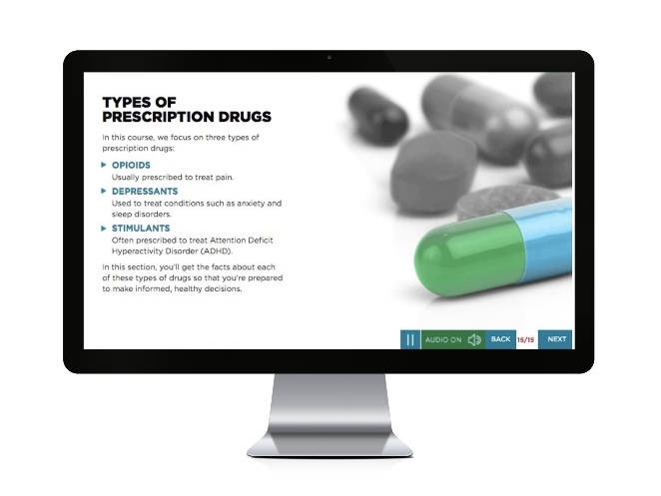

About Mental Well-Being for Students
The Benefits of Working
with Vector Solutions
Mental Well-Being for Students Course
Objectives
Proven Efficacy
Nine independent studies have been published demonstrating the efficacy of Vector Solutions’ online programs. Our approach improves knowledge, attitudes, and behaviors.
Reduce the stigma
surrounding mental health and promote conversations about well-being
True Expertise
Our team includes public health professionals, administrators from student affairs, campus prevention offices, legal experts, and more. Extend your team by partnering with ours.
Introduce strategies
for approaching challenges, including self-management, self-advocacy, and building a support system
Beyond Compliance
Our online programs are built by prevention and compliance experts to meet and exceed requirements from Title IX, Clery Act, and EDGAR part 86.
Empower learners
to support peers in crisis situations
Data Driven
Our data and analytics provide real-time access to attitudinal and behavioral data from your unique populations, and national benchmarks to assess needs and strengths.
Connect learners
with campus-based support and local resources

