Slide 1
Sexual Assault Prevention for Undergraduates
Georgia Institute of Technology
Impact Report | 2022–2023 Academic Year

Slide 2

Dear Georgia Institute of Technology Partner,
I am pleased to provide your 2022-2023 Impact Report for Sexual Assault Prevention for Undergraduates. This year’s report includes key insights from your Vector Solutions program, demonstrating the impact of your investment in the health, safety, and well-being of your students and employees.
Prevention efforts have always been central to the mission of higher education. However, emerging insights elevate and reposition this important work in the evolving context of our industry and the communities we serve.
In a recent Vector Solutions survey of current college students, safety, well-being, and inclusion were as important as reputation, academic rigor, and affordability in their decision of which college to attend. Similarly, student well-being initiatives were more strongly correlated with college satisfaction than any other factor, including cost, rigor, and academic opportunity.
Data from Vector Solutions’ campus climate survey showed that students who participated in prevention programs were 50% more likely to feel valued in the classroom, happy to be at their school, and a greater sense of belonging versus students who did not participate in these programs.
Institutions that are maximizing their use of digital prevention programs have, on average, a 10% higher first-year retention rate compared to institutions that are not achieving similar standards.* Over one-third of graduating high school seniors said they’re more likely to attend these leading prevention institutions.
Prevention programming is also fostering the development of critical skills for supporting students in their lives after college. Two-thirds of students who participated in Vector Solutions’ prevention programs said that the course made them feel better prepared and qualified for future jobs. Over 70% felt they had better understanding and awareness of the wider world.
As you delve into the insights in this year’s Impact Report, I encourage you to consider the many ways our work together drives outcomes that not only enhance the well-being of your community but also the performance of your institution. These strategic connections demonstrate that prevention is both mission- and business-critical for the future of higher education.
And working together, that future is abundantly bright.
Rob Buelow
Head of Product, Education
Vector Solutions
* These data are based on the 2022 recipients of the Campus
Prevention Network Seal of Prevention.

Slide 3
Table of Contents
How to Use This Report | 4
Executive Summary | 5
Impact Snapshot | 6
SAPU and Your Students | 10
Knowledge Gain | 11
Knowledge Gains and Learner Impact | 12
Healthy Relationships and Consent | 13
Supporting Survivors | 14
Sexual Assault Prevention on Your Campus | 15
Engaging the Healthy Majority | 16
Personal Experiences by Gender Identity | 17
Bystander Behaviors – Male-Identifying Students | 18
Bystander Behaviors – Female-Identifying Students | 19
Social Norms for Behavior | 20
Campus Climate | 21
Community Readiness | 22
Engaging Your Students | 23
Appendix – Student Demographics | 24
Supplemental Information | 27
Prevention Framework | 28
About Sexual Assault Prevention for Undergraduates | 29
Sexual Assault Prevention for Undergraduates Course Map | 30

Slide 4

How To Use
This Report
Peer Institution Benchmarks
Campus Prevention
Network Framework Tips
Sharable Snapshot
For select data points in this report, you will see comparisons to peer institution benchmarks. These peer institutions are similar to you in size, and public or private status. Georgia Institute of Technology is a large public institution, so your benchmarks reflect other public schools with 20,000 or more students.
The Campus Prevention Network Framework for Prevention describes the elements of effective prevention efforts: Institutionalization, Critical Processes, Policy, and Programming. Throughout this report, you will find Tips and further research related to these prevention elements.
At the end of this report, you will find a snapshot of select data from your report. This snapshot is designed to be shared with other stakeholders at your institution. We hope that you will print these pages out and pass them along to your Vice President of Student Affairs, Provost, or other members of your team.
This report provides key insights from your Sexual Assault Prevention for Undergraduates data. We encourage you to explore the data in the report, think about how you can use it to inform prevention efforts across your institution, and share it with others on your campus.
To help you make the most of this report, we have included benchmarks to help you understand where you stand relative to peer institutions, provided recommendations throughout the report tied to a framework for prevention, and included a sharable snapshot of your data at the end of this report.
For deeper insights, the administrator site provides real-time access to your data, in both graphical and raw data formats.
Data in this Report
Data Accuracy
The data included in this report were collected on the Foundry platform between June 1, 2022 and January 26, 2023. Insights and analyses in this report are based on your students' responses to pre-course and post-course surveys. Overall, 3,610 students completed pre-course surveys, and 2,942 completed post-course surveys.
While learners are encouraged to answer all questions honestly and reminded that their responses are stored confidentially, all survey questions are optional, and all data are self-reported. However, in our analysis of the responses, we find the data to be accurate, valid, and reliable. There is consistency in the data from student cohorts over the years at specific institutions, and our survey data correlates with external sources of information on these topic areas at the national and institutional level for college students.

Slide 5
Executive
Summary
This school year,
3,610 Georgia Institute of Technology students took part in Sexual Assault Prevention for Undergraduates (SAPU). This course, developed by prevention education and compliance experts, uses relatable scenarios and interactive elements to provide students with strategies for healthy behavior and skills to support bystander intervention.
Course Impact
SAPU is designed to equip your students with knowledge and skills to support healthier decisions related to romantic relationships, sexual interactions, consent, and supporting peers on their campus.
When it comes to skills, 82% of Georgia Institute of Technology students agreed that SAPU helped them identify characteristics of healthy and unhealthy relationships, and 81% reported that the education increased their confidence in their ability to intervene when they witnessed concerning behavior.
Behavioral Intentions & Norms
Change is driven, in part, by an individual’s perception of the social environment surrounding behavior — the community norms.
Most students taking this course report healthy attitudes and behaviors related to sex and relationships. This includes 94% of students who say they would refrain from sexual activity if the other person was incapacitated, but only 57% of those same students believe their peers would do the same.
Among students at Georgia Institute of Technology who took SAPU, 39% agreed that they could play a role in preventing sexual assault on their campus. And a substantial number of your students, after taking SAPU, reported that they knew how to report a sexual assault at their school. Further, 79% felt that your institution offered good resources for students going through difficult times.
Your Sexual Assault Prevention for Undergraduates Impact Report includes detailed information about how your students think, feel, and behave in romantic and sexual relationships. This data can be invaluable in guiding your prevention programming for maximum impact.

Slide 6
Sexual Assault Prevention for Undergraduates
Impact Snapshot

Slide 7

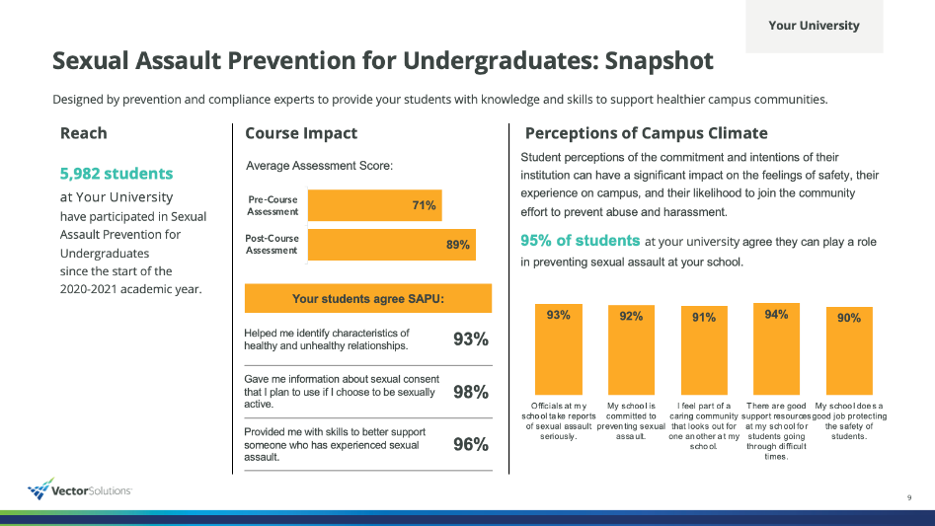
Impact Snapshot
In order to make the content of this report easier
to share with your colleagues and stakeholders,
we have included a Snapshot section that highlights and visually displays the most salient data points from the full report.
This can help your data get more traction and increase interest in the full report and the Sexual Assault Prevention for Undergraduates program at large.
We recommend excerpting this Snapshot section from the full report and sharing with stakeholders, colleagues, and students who might be interested in the impact of the SAPU program but have less direct experience in prevention work.

Slide 8
Sexual Assault Prevention for Undergraduates: Snapshot
Georgia Institute of Technology
Designed by prevention and compliance experts to provide your students with knowledge and skills to support healthier campus communities.
Reach
Course Impact
Perceptions of Campus Climate
3,610 students
at Georgia Institute of Technology
have participated in Sexual Assault Prevention for Undergraduates
since the start of the
2022-2023 academic year.
Student perceptions of the commitment and intentions of their institution can have a significant impact on the feelings of safety, their experience on campus, and their likelihood to join the community effort to prevent abuse and harassment.
39% of students at Georgia Institute of Technology agree they can play a role in preventing sexual assault at your school.
Your students agree SAPU:
Helped me identify characteristics of healthy and unhealthy relationships. | 82%
Gave me information about sexual consent that I plan to use if I choose to be sexually active. | 84%
Provided me with skills to better support someone who has experienced sexual assault. | 83%
Notes:
Assessment
|post|
|pre|
>>>>>>>>>>
Campus
|sapu2_6a|
|sapu2_6b|
|sapu2_6c|
|sapu2_6d|
|sapu2_6e|

Slide 9
Sexual Assault Prevention for Undergraduates: Snapshot
Georgia Institute of Technology
Preferred Bystander Behaviors
Bystander Intervention
Bystander Intervention Scenarios
Female-Identifying Students
1 | Asking the person who you’re concerned about if they need help.
2 | Finding the friends of those involved and asking them for help.
3 | Following up later to check in with the person who you were concerned about.
Proactive bystander behaviors —stepping in directly or engaging other observers indirectly — are some of the most important ways students can support and build a healthy campus environment.
SAPU helps students build their bystander skills. Georgia Institute of Technology can use this information to continue to develop those skills as part of a healthy campus community.
Male-Identifying Students
1 | Asking the person who you’re concerned about if they need help.
2 | Finding the friends of those involved and asking them for help.
3 | Following up later to check in with the person who you were concerned about.
Tip
Research has shown that male-identifying students may be more likely to engage in active, confrontational bystander behaviors than their female-identifying peers. While it is encouraging to know that students are interested in stepping in to help peers, not every situation calls for a specific type of response. Students should be encouraged to engage in a wide range of behaviors and helped to understand which strategies should be employed for maximum effectiveness.
81% of students at Georgia Institute of Technology agree that SAPU made them more confident in their ability to intervene when they see concerning behavior.
Notes:
|sapu2_2a|
|sapu2_2am|
|sapu2_2b|
|sapu2_2bm|
|sapu2_2c|
|sapu2_2cm|
|sapu2_2d|
|sapu2_2dm|

Slide 10
SAPU and Your Students
Impact at Georgia Institute of Technology

Slide 11
Knowledge Gain
Georgia Institute of Technology
Assessments in SAPU, which students take before and after the course, are designed to measure their comprehension and knowledge of topics related to sexual assault.
Programming Tip
Where are your students knowledgeable and where is there room to learn more? SAPU is intended to provide foundational knowledge and skills that can be built upon. Knowledge data can inform which content areas should be built out or reinforced as part of your ongoing prevention efforts.
Notes:
|pre_1|
|post_1|
|pre_2|
|post_2|
|pre_3|
|post_3|
|pre_4|
|post_4|
|pre_5|
|post_5|

Slide 12
Knowledge Gains and Learner Impact
Georgia Institute of Technology
After taking SAPU, students were asked to reflect on the course experience and tell us how the course impacted their awareness, knowledge, and skill in ways that will help them to make healthier decisions and support their peers in the future.
Your students reported that SAPU:
Made me more confident in my ability to intervene when I see concerning behavior. | 81%
Helped me identify characteristics of healthy and unhealthy relationships. | 82%
Taught me where to find resources for sexual assault and abusive relationships at my school. | 79%
Provided me with skills to better support someone who has experienced sexual assault. | 83%
Increased my understanding of school policies related to issues covered in the course. | 82%
Gave me information about sexual consent that I plan to use if I choose to be sexually active. | 84%
Programming Tip
How can you reinforce students’ skills and feelings of self-efficacy throughout the year and over your students’ college careers? Ongoing training — both annually online and through in-person opportunities such as workshops, role-playing, peer conversations — can reinforce key information, allow students to practice their skills, and build confidence.
Percentages represent the share of students who agreed with these statements in the Post-Course Survey (Survey 2).

Slide 13
Healthy Relationships and Consent
Georgia Institute of Technology
In addition to developing knowledge, SAPU helps students build skills and attitudes they can use to support a healthy community. These include identifying unhealthy situations, supporting friends, and modeling attitudes that reflect healthy community norms.
Programming Tip
Research has shown that young adults are likely to overestimate their own abilities, particularly when it comes to areas where they have not had to employ those skills. This leads to some students feeling overconfident in the pre-course survey, but after taking the course, they may acquire a more nuanced perspective, which can help explain the flat or slight decrease in healthy responses pre-to-post course that you may see in the chart on this page.
Notes:
|sapu1_1e|
|sapu2_1e|
|sapu1_1d|
|sapu2_1d|
|sapu1_1ab|
|sapu2_1ab|
|sapu1_1a|
|sapu2_1a|

Slide 14
Supporting Survivors
Georgia Institute of Technology
Maintaining a healthy community requires supporting community members who experience sexual assault. SAPU covers: access to support and reporting resources, intervening in unhealthy situations and supporting others, and addressing attitudes of victim blaming when a sexual assault occurs.
Critical Processes Tip :
To learn more about what your colleagues are doing on their campuses, what is being shown to work in research, and to connect with others trying to prevent sexual assault and domestic violence in higher education, join the Campus Prevention Network at: https://www.vectorsolutions.com/networks/campus-prevention-network/
Notes:
|sapu1_1q|
|sapu2_1q|
|sapu1_1b|
|sapu2_1b|
|sapu1_1g|
|sapu2_1g|
|sapu1_1o|
|sapu2_1o|
|sapu1_1j|
|sapu2_1j|

Slide 15
Sexual Assault Prevention On Your Campus
Data and Insights From Students at Georgia Institute of Technology

Slide 16

Engaging the Healthy Majority
Georgia Institute of Technology
SAPU data shows that most students have healthy attitudes and behaviors related to relationships. Although it is often tempting to focus on the relatively small group of “unhealthy” students, engaging the “healthy majority” can create a culture of care and accountability that helps build a safe community.
In addition to reporting on the personal experiences of your students, the following pages highlight topics that can help you understand how to engage and bolster the healthy majority on your campus: bystander intervention, social norms, perceptions of campus climate, and readiness to engage in prevention efforts on your campus.
Most college
students have healthy
attitudes and behaviors
when it comes to relationships.
Healthy Attitudes and Behaviors
Unhealthy Attitudes and Behaviors
Critical Processes Tip
Reflect on the share of your sexual assault prevention programming and policies that is focused on supporting the healthy majority, compared to addressing or disciplining the unhealthy minority. Are there areas where you could supplement or expand efforts that develop a positive culture on your campus?

Slide 17
Personal Experiences By Gender Identity
Georgia Institute of Technology
Some of your students will arrive on campus with personal experience with sexual assault, relationship violence, or stalking. Others may have these experiences after they become members of your community.
 | Female-Identifying |  | Male-Identifying
 | Before | After | Before | After
Sexual Assault | 5.54% | 0.44% | 1.71% | 0.15%
Relationship Violence | 2.52% | 0.26% | 1.20% | 0.11%
Stalking | 8.37% | 0.58% | 2.37% | 0.29%
Sexual Assault
In the past, someone pressured or forced me into sexual contact without my explicit consent.
Relationship Violence
I have experienced some form of abuse or threats of abuse in a current or previous relationship.
Stalking
In the past, I have experienced repeated and unwanted attention, harassment, or other contact from another person that has made me feel afraid.
Note
Vector Solutions recognizes and appreciates that everyone may not identify with either of these two gender identities. While this report presents comparisons between students who identify as male or female, the survey presented additional non-binary options for students to self-identify including an option to write-in how they identify. To examine attitudes, experiences, and behaviors of additional gender identities, you can access your institution’s data through the administrator site.
Critical Processes Tip
Notice how personal experiences may be different for male and female students. Think about what other demographic characteristics may have an influence on personal experiences at your institution, including race, ethnicity, group membership, year in school, sexual orientation, etc..

Slide 18
Bystander Behaviors - Male-Identifying Students
Georgia Institute of Technology
Proactive bystander behaviors — stepping in directly or engaging other observers indirectly — are some of the most important ways students can support and build a healthy campus environment. On the right is a summary of when male-identifying students on your campus have intervened, and their preferred strategies for doing so.
Bystander Intervention Scenario
I spoke up when I heard someone saying something I found offensive or demeaning. | 90%
I expressed concern when I saw a person exhibiting abusive behavior toward their partner. | 95%
I helped someone get support or find resources when they told me about an unwanted sexual experience. | 89%
I intervened when I saw someone trying to take advantage of someone else sexually. | 92%
Programming Tip
Research has shown that male identifying students may be more likely to engage in active, confrontational bystander behaviors than their female-identifying peers. While it is encouraging to know that students are interested in stepping in to help peers, not every situation calls for a specific type of response. Students should be encouraged to engage in a wide range of behaviors and helped to understand which strategies should be employed for maximum effectiveness.
Note: Percentages are of students who indicated they have been present in the described scenario.
Preferred Bystander Behaviors
Male-identifying students are most likely to express confidence in engaging in the following three behaviors if they observed a potential sexual assault situation:
Asking the person who you’re concerned about if they need help.
Finding the friends of those involved and asking them for help.
Following up later to check in with the person who you were concerned about.

Slide 19
Bystander Behaviors - Female-Identifying Students
Georgia Institute of Technology
Understanding how your students prefer to stand up for one another can help you develop strategies to reinforce those strengths, and to help students feel more supported when they do stand up. Below are the preferred bystander behaviors for female-identifying students on your campus.
Bystander Intervention Scenario
I spoke up when I heard someone saying something I found offensive or demeaning. | 92%
I expressed concern when I saw a person exhibiting abusive behavior toward their partner. | 96%
I helped someone get support or find resources when they told me about an unwanted sexual experience. | 92%
I intervened when I saw someone trying to take advantage of someone else sexually. | 93%
Programming Tip
Given that students with different identities report different experiences, attitudes, and behaviors, it is important to consider additional resources that may be directed towards specific student populations on campus. These efforts may focus on high-risk student sub-groups, and we also suggest using targeted supplemental education and resources for under-represented identities to help all students feel safe and welcome on campus.
Note: Percentages are of students who indicated they have been present in the described scenario.
Preferred Bystander Behaviors
Female-identifying students are most likely to express confidence in engaging in the following three behaviors if they observed a potential sexual assault situation:
Asking the person who you’re concerned about if they need help.
Finding the friends of those involved and asking them for help.
Following up later to check in with the person who you were concerned about.

Slide 20
Social Norms for Behavior
Georgia Institute of Technology
An individual is more likely to act in a particular way if they believe their actions will be supported by their peers. However, research shows that there is often a gap between what an individual thinks they would do (the “actual norm”), and what they believe their peers would do (the “perceived norm”). This is called the ”norms gap.” SAPU aims to decrease the norms gap among your students so they’ll be more likely to engage in positive behaviors on campus.
Norms Gap, Before Course
28 points
27 points
24 points
40 points
15 points
Programming Tip
Feelings of not being supported by other members of a social group or community are likely to be an obstacle to intervening, standing up to concerning behavior, and supporting friends and peers. You can examine the norms gap between subgroups by using data from your administrator site and looking into which groups could use additional training and support to close the norms gap.
Norms Gap, After Course
20 points
16 points
17 points
37 points
8 points
Notes:
BeforeCourse
|sapu1_1c|
|sapu1_1r|
|sapu1_1m|
|sapu1_1n|
|sapu1_1t|
|sapu1_1p|
|sapu1_1f|
|sapu1_1aa|
|sapu1_1s|
|sapu1_1l|
>>>>>>>>>>>>>>>>>>>>>
AfterCourse
|sapu2_1c|
|sapu2_1r|
|sapu2_1m|
|sapu2_1n|
|sapu2_1t|
|sapu2_1p|
|sapu2_1f|
|sapu2_1aa|
|sapu2_1s|
|sapu2_1l|

Slide 21
Campus Climate
Georgia Institute of Technology
After completing the course, students answered a series of questions related to the climate around sexual assault at their school. This information can help you understand the degree to which your institution’s sexual assault prevention efforts are impacting student perceptions of the campus environment.
Institutionalization Tip
Students’ perceptions of the commitment and intentions of their institution can have a significant impact on their feelings of safety and support, their experience while on campus, and their likelihood to join the community effort to prevent abuse and harassment. These may be very valuable data points to share with administrators to show how students are feeling about the climate at your institution and for senior leaders to consider when communicating publicly about the expectations of students in their community.
Notes:
|sapu2_6a|
|sapu2_6ap|
|sapu2_6b|
|sapu2_6bp|
|sapu2_6c|
|sapu2_6cp|
|sapu2_6d|
|sapu2_6dp|
|sapu2_6e|
|sapu2_6ep|

Slide 22
Community Readiness
Georgia Institute of Technology
After completing the course, students answered questions about their readiness to address sexual assault at their school — from identifying sexual assault as an issue worthy of their attention, to getting personally involved in prevention efforts.
Programming Tip
These categories from left to right represent a continuum of readiness to support prevention efforts on your campus. While most students come to school with a healthy and open mindset, it is important to consider how prevention efforts are influencing all students across this continuum and how we can pull those from the least desirable categories towards a more positive perspective towards community at your institution.
Notes:
|sapu2_3a_1|
|sapu2_3ap_1|
|sapu2_3a_2|
|sapu2_3ap_2|
|sapu2_3a_3|
|sapu2_3ap_3|
|sapu2_3a_4|
|sapu2_3ap_4|
|sapu2_3a_5|
|sapu2_3ap_5|

Slide 23

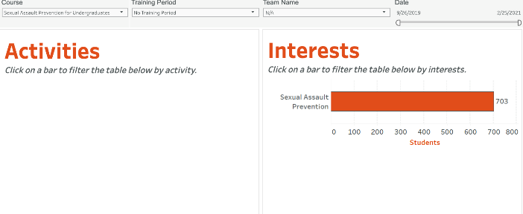
Engaging Your Students
Effective prevention includes actively engaging students to reinforce positive behavioral intentions of a majority of the campus community.
A growing number of students are arriving on campus already aware of the importance of supporting healthy relationships and consensual sexual activity and wish to connect with peers who share these values. Sexual Assault Prevention for Undergraduates provides campuses with a unique tool to identify and assist students with that process. At Georgia Institute of Technology, many of your students have opted in to be contacted by your institution about getting more involved in creating a safe and inclusive community.
It is very likely that these students who volunteered to be contacted represent the healthier end of the Community Readiness spectrum on the previous page, but education and resources for support should also be directed toward those who are not ready to acknowledge this is an issue on their campus. Make sure to highlight the work you do to incorporate student voices in the generation of programs and policies at your institution.
Engaging students who are excited to learn and participate more in your prevention efforts and publicizing that collaboration helps to show how most students support a safe community, healthy behavior, and personal responsibility.
Programming Tip
Your students provided their names and email addresses so they can be contacted to get more involved in sexual assault prevention and education. This list of students can be downloaded from your administrator site.

Slide 24
Sexual Assault Prevention for Undergraduates
Appendix – Student Demographics

Slide 25
Student Demographics
The following is a summary of the demographics of students who participated in SAPU this year. Demographic information is self-reported by students as part of pre-course survey (Survey 1). All questions are optional, and students may choose not to share demographic information.
 | Heterosexual/Straight | 79% |  | Bisexual | 8%
 | Gay | 1% |  | Lesbian | 2%
 | Questioning | 5% |  | Other responses | 7%
 | Prefer not to answer | 5%
 | Female | 40% |  | Prefer to self-describe | 0%
 | Male | 56% |  | Prefer not to answer | 2%
 | Non-binary | 1% | 1%
‘Other responses’ reflects the number of students who selected Asexual, Queer, or Prefer to self-describe.
Do you identify as trans (e.g., transgender, transsexual, a person with transitioning sex or gender history, etc.)?
Yes | 1% | No | 97% | Not sure | 1% | Prefer not to answer | 2%
Notes:
GenderIdentity
|fem|
|mal|
|trns|
|oth|
|pna|
>>>>>>>>>>>>>>>>>
SexualOrientation
|het|
|bis|
|gay|
|les|
|ques|
|otr|
|pna_so|

Slide 26
Student Demographics (Continued)
 | 17 Years or younger | 13% |  | 18 Years | 68%
 | 19 Years | 13% |  | 20 Years | 3%
 | 21+ Years | 3%
Notes:
Ethnicity
|black|
|white|
|hispanic|
|asian|
|native|
|other|
>>>>>>>>>>>>>>>>>>>>>
Age
|sev|
|eig|
|nin|
|twe|
|two|

Slide 27
Sexual Assault Prevention for Undergraduates
Supplemental Information

Slide 28
The Prevention Framework
Policy
Institutionalization
Critical Processes
Programming
Prevention training, programs and communication strategies that maximize engagement and drive impact
The Prevention Framework, developed by Vector Solutions’ Campus Prevention Network, defines the elements of a comprehensive approach to prevention, and the ways in which those elements build to an effective prevention program.
The values and expectations of the organization, and the-system of accountability to uphold and enforce them
Using goal setting, strategic planning, and data analysis to inform and evaluate prevention work
System-wide buy-in, visible commitment, and investment in effective prevention initiatives

Slide 29
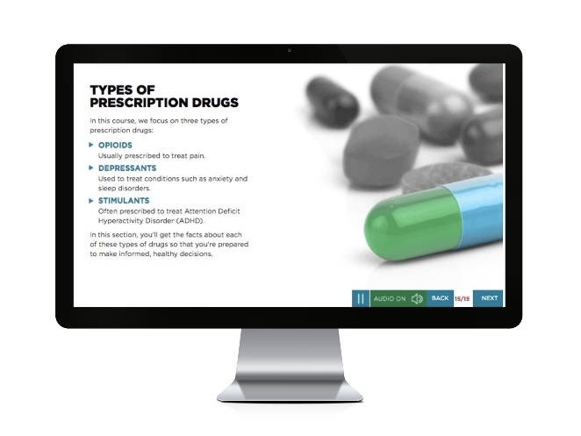
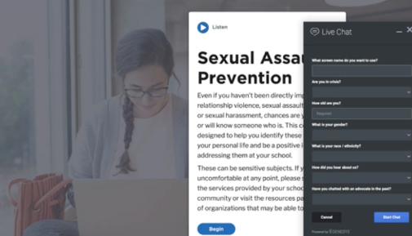
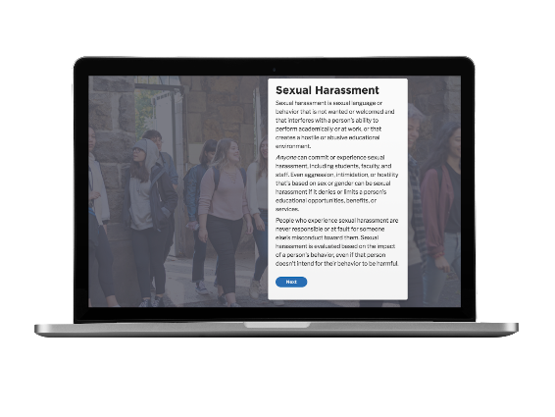
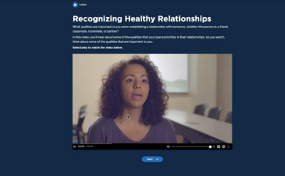
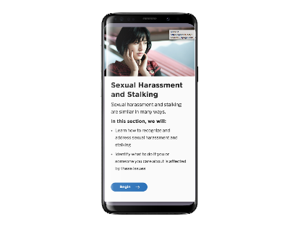
About Sexual Assault Prevention for Undergraduates
The Benefits of Working
with Vector Solutions
Sexual Assault Prevention for
Undergraduates
Proven Efficacy
Nine independent studies have been published demonstrating the efficacy of Vector online programs. Our approach improves knowledge, attitudes, and behaviors.
Helps meet or exceed
Title IX and Clery Act requirements.
True Expertise
Our team includes public health professionals, administrators from student affairs, campus prevention offices, legal experts, and more. Extend your team by partnering with ours.
Developed in collaboration
with leading prevention experts and researchers.
Beyond Compliance
Our online programs are built by prevention and compliance experts to meet and exceed requirements from Title IX, Clery Act, and EDGAR part 86.
Informed by Emerging Research
on evidence-based practice (e.g., social norms approach, bystander intervention).
Data Driven
Our data and analytics provide real-time access to attitudinal and behavioral data from your unique populations, and national benchmarks to assess needs and strengths.
Shown to have impact
on student attitudes and intentions at a campus-level in peer-reviewed publication.

Slide 30
Sexual Assault Prevention for Undergraduates Course Map
Part 1 | 1. Introduction Welcome Sexual Assault Prevention What Do You Think? Your Voice, Your Experience | Pre-Course Survey (Survey 1) | Pre-Course Quiz | 2. Values, Identities, & Relationships Who am I? Our Unique Identities Our Values Local Support Information | 2. Values, Identities, & Relationships Who am I? Our Unique Identities Our Values Local Support Information | Pre-Course Quiz | 3. Identities and Stereotyping Why are Gender Stereotypes Harmful? What Can You Do About Harmful Language? Title IX of the Education Amendments Act of 1972 Sexual Misconduct Policy
 | 4. Our Values and Relationships Recognizing Healthy Relationships Recognizing Relationship Abuse Federal and State Laws: Relationship Violence Resources Understanding the Warning Signs of Digital Abuse Using Strategies to Stay Safe |  | 5. Consent, Coercion, & Bystander Intervention Consent: Part of Healthy Communication What Does Consent Look Like? Understanding Consent Coercion What Does Coercion Look Like? Alcohol and Coercion State Law: Consent Federal and State Laws: Sexual Assault |  |  | 5. Consent, Coercion, & Bystander Intervention Consent: Part of Healthy Communication What Does Consent Look Like? Understanding Consent Coercion What Does Coercion Look Like? Alcohol and Coercion State Law: Consent Federal and State Laws: Sexual Assault | 6. Sexual Harassment and Stalking Sexual Harassment Forms of Sexual Harassment Responding to Sexual Harassment Stalking Federal and State Laws: Stalking
 | 7. Reporting and Responding Impact of Trauma How Identities May Impact Survivors’ Experiences Responding to Survivors National Resources, School and Local Resources Student Engagement Survey Reporting Reporting Options and Processes State Law: Legal Protections Reporting Resources |  | Post-Course Exam |  | 8. Conclusion Course Summary | 8. Conclusion Course Summary
Part 2 | Intersession |  | Follow-up Survey (Survey 2)

