Slide 1
Mental Well-Being for Students
Georgia Institute of Technology
Impact Report | 2023–2024 Academic Year

Slide 2

Dear Georgia Institute of Technology Partner,
I am pleased to provide your 2023-24 Impact Report for Mental Well-Being for Students. This year’s report includes key insights from your Vector Solutions program, demonstrating the impact of your investment in the health, safety, and well-being of your students.
As a public health professional, I think often about prevention as a process – not a program. We’ve built our courses and surveys to align with best practices and support you in the prevention process. Here are some guiding points and questions to help you make the most of your Vector data:
When it comes to safety and wellness, scale and impact matters. How are you highlighting the reach and results of your online programming to garner visibility and support for your work? Leading institutions share their data in cabinet-level briefs, in Annual Security Reports, in marketing and PR efforts, and even to support accreditation.
Our courses and surveys address a range of factors that influence behavior change: knowledge and awareness, attitudes and beliefs, perceived outcomes, personal and social norms, behavioral skills, perceived behavioral control, and cues to action. How can these data inform where to focus additional resources (and where to pull back)?
Most learners have incredibly positive attitudes and behaviors related to issues of wellness and safety, even before training. Overcoming *inaction* of those who want to make a difference in unsafe situations can be even more powerful than focusing on individual actions of those committing harm. How can you leverage your data to elevate and empower the “healthy majority” as changemakers?
Are you adding custom survey questions in your courses? Are you using disaggregated survey data to conduct additional analyses (e.g., exploring differences based on demographic sub-groups)? *
The scalable reach and data from your Vector Solutions programs can be a springboard to more informed and effective engagement with your community. As you delve into the insights in this Impact Report, consider strategic ways to utilize these data to strengthen the prevention process at your institution.
Your partner in prevention,
Rob Buelow
VP and General Manager, Education
Vector Solutions
* Reach out to your Vector Solutions representative with questions about capabilities available to your institution.

Slide 3
Table of Contents
How to Use This Report | 4
Executive Summary | 5
Impact Snapshot | 6
Mental Well-Being for Students and Your Students | 9
Seeking Help and Support for Mental Health | 10
Supporting Others in the Community | 11
Mental Well-Being on Your Campus | 12
A Continuum of Student Mental Health | 13
Social Norms for Behavior | 14
Proactive Bystander Behaviors | 15
Barriers to Accessing Care | 16
Campus Climate | 17
Community Readiness | 18
Appendix – Student Demographics | 19
Supplemental Information | 22
Prevention Framework | 23
About Mental Well-Being for Students | 24

Slide 4

How To Use This Report
Peer Institution Benchmarks
Campus Prevention Network Framework Tips
Sharable Snapshot
For select data points in this report, you will see comparisons to peer institution benchmarks. These peer institutions are similar to yours in size and public or private status. Georgia Institute of Technology is a public institution with 10,000 to 19,999 students, so your benchmarks reflect that particular group of schools.
The Campus Prevention Network Framework for Prevention describes the elements of effective wellness and prevention efforts: Institutionalization, Critical Processes, Policy, and Programming. Throughout this report, you will find tips and further research related to these prevention elements.
At the beginning of this report, you will find a snapshot of select data from your report. This snapshot is designed to be shared with other stakeholders at your institution. We hope that you will print these pages out and pass them along to your Vice President of Student Affairs, Provost, or other members of your team.
This report provides key insights from your Mental Well-Being for Students data. We encourage you to explore the data in the report, think about how you can use it to inform prevention efforts across your institution, and share it with others on your campus.
To help you make the most of this report, we have included benchmarks to help you understand where you stand relative to peer institutions, provided recommendations throughout the report tied to a framework for prevention, and included a sharable snapshot of your data at the beginning of this report.
For deeper insights, your Vector Solutions administrator site provides real-time access to your survey data, in both graphical and raw data formats.
Data in this Report
Data Accuracy
The data included in this report were collected between
June 1, 2023 and February 26, 2024. Insights and analyses in this report are based on your students' responses to
Pre-Course, Post-Course, and Follow-Up (Part Two) Surveys. Overall, 3,742 students completed pre-course surveys, 3,053 completed post-course surveys, and 2,171 completed follow-up surveys.
While learners are encouraged to answer all questions honestly and reminded that their responses are stored confidentially, all survey questions are optional and all data are self-reported. However, in our analysis of the responses, we find the data to be accurate, valid, and reliable. There is consistency in the data from student cohorts over the years at specific institutions, and our survey data correlates with external sources of information on these topic areas at the national and institutional level for college students.

Slide 5
Executive Summary
This school year,
3,742 Georgia Institute of Technology students completed surveys in Mental Well-Being for Students (MWBS) from June 1, 2023 to February 26, 2024. This course, developed by prevention education and subject matter experts, uses relatable scenarios and interactive elements to provide students with strategies for healthy behavior and skills to support community members.
Course Impact
Mental Well-Being for Students is designed to equip your students with knowledge and skills to support their own and their peers’ mental well-being, and to access support when needed.
Georgia Institute of Technology students increased their knowledge of topics related to mental well-being by 18%. When it comes to skills, after completing Mental Well-Being for Students, 86% of students say they would know how to access help if they needed it and 66% of students agree that they are responsible to help if a classmate is struggling.
Behavioral Intentions & Norms
Change is driven, in part, by an individual’s perception of the social environment surrounding behavior — the community norms.
Most students taking this course report healthy, desirable attitudes and behaviors related to mental well-being, their ability to manage challenging situations, and the desirability of seeking help. This includes 85% of students who believe it is healthy to discuss mental health concerns and 86% who would support someone else who was seeking help for mental health reasons.
Among students at Georgia Institute of Technology who took Mental Well-Being for Students, 17% are currently involved, or plan to get involved, in efforts to support mental health on their campus. And though students do, at times, encounter barriers when accessing help, 66% of students agree that students’ mental and emotional well-being is a priority at your school.
Your Mental Well-Being for Students Impact Report includes detailed information about how your students think, feel, and behave regarding mental well-being. This data can be invaluable in guiding your programming for maximum impact.

Slide 6
Mental Well-Being for Students
Impact Snapshot
In order to make the content of this report easier to share with your colleagues and stakeholders, we have included a Snapshot section that highlights and visually displays the most salient data points from the full report.
This can help your data get more traction and increase interest in the full report and the Mental Well-Being for Students program at large.
We recommend excerpting this Snapshot section from the full report and sharing with stakeholders, colleagues, and students who might be interested in the impact of the Mental Well-Being for Students program but have less direct experience in prevention work.

Slide 7
Mental Well-Being for Students: Snapshot
Georgia Institute of Technology
Designed by prevention and compliance experts to provide your students with knowledge and skills to support healthier campus communities.
Sample Size
Course Impact
Students increased their prevention knowledge, and their skills associated with healthier behavior.
Perceptions of Campus Climate
3,742 students
at Georgia Institute of Technology completed surveys in Mental Well-Being for Students from June 1, 2023 to February 26, 2024.​
Student perceptions of the commitment and intentions of their institution can have a significant impact on the feelings of safety, their experience on campus, and their likelihood to join the community effort to address mental well-being.
17% of students at Georgia Institute of Technology are currently or plan to be involved in supporting mental health at your school.
After taking Mental Well-Being for Students, your students agree:
Seeking help for my mental health can make a positive difference. | 90%
My mental health can improve over time. | 90%
I have the ability to make a difference in the mental health of others. | 89%
Notes:
Assessment
|post_avg|
|pre_avg|
>>>>>>>>>>>>
campusGraph
|cr1|
|cr2|
|cr3|
|cr4|

Slide 8
Mental Well-Being for Students: Snapshot
Georgia Institute of Technology
Bystander Intervention
Top Bystander Behaviors
Barriers to Accessing Care
Not all students who feel that they need support for their mental health are able to access formal care. Among your students who indicate a need for mental health services, here are the top barriers to receiving care:
Proactive bystander behaviors —stepping in directly or engaging other observers indirectly — are some of the most important ways students can support and build a healthy campus environment.
Mental Well-Being for Students helps students build their bystander skills. Georgia Institute of Technology can use this information to continue to develop those skills as part of a healthy campus community.
When they intervened in mental health situations, your students most often employed one of the following behaviors:
1 | Expressed my concern for their well-being to them directly
2 | Listened to them talk about their issues or distress
3 | Checked in with the person I was concerned about at a later time
89% of students at Georgia Institute of Technology believe they have the ability to make a difference in the mental health of others.
24% of students at Georgia Institute of Technology reported needing help for emotional or mental health problems, feeling blue, anxious, or nervous sometime in the last 12 months.
Notes:
BarriersGraph
|text1|
|text2|
|text3|
|text4|
|br1|
|br2|
|br3|
|br4|

Slide 9
Mental Well-Being for Students and Your Students
Impact at Georgia Institute of Technology

Slide 10
Seeking Help and Support for Mental Health
Georgia Institute of Technology
Mental Well-Being for Students helps students build skills and attitudes they can use to support a healthy community. These include identifying unhealthy behaviors, seeking help from their institution, and support from others.
(n = 3,742)
(n = 3,053)
Critical Processes Tip
Research has shown that young adults are often likely to overestimate their own abilities, particularly when it comes to areas where they have not had to employ those skills but have a strong urge to provide the desirable answer when questioned. Because of this, some students may feel overconfident in their own attitudes and behaviors at the pre-course survey but acquire a more nuanced perspective after the course. This can explain some of the flat or slight decrease in healthy responses pre-to-post course that you may see in the chart on this page.
Notes:
|HealthPre1|
|HealthPost1|
|HealthPre2|
|HealthPost2|
|HealthPre3|
|HealthPost3|
|HealthPre4|
|HealthPost4|

Slide 11
Supporting Others in the Community
Georgia Institute of Technology
Part of maintaining a healthy community is supporting members who experience mental health challenges. Mental Well-Being for Students discusses access to support and reporting resources, intervening in unhealthy situations and supporting others in the community.
(n = 3,742)
(n = 3,053)
Note: Percentages represent students that responded “agree" or "strongly agree” for each item.
Notes:
|CommunityPre1|
|CommunityPost1|
|CommunityPre2|
|CommunityPost2|
|CommunityPre3|
|CommunityPost3|
|CommunityPre4|
|CommunityPost4|

Slide 12
Mental Well-Being On Your Campus
Data and insights from students at Georgia Institute of Technology

Slide 13
A Continuum of Student Mental Health
Georgia Institute of Technology
As institutions of higher education seek to educate the whole student, they must also explore ways in which they can provide skills training to students to promote positive mental health and encourage seeking support when faced with challenges. You have likely deployed Mental Well-Being for Students as part of this effort.
Ongoing efforts must be put in place with an awareness of all perspectives across the student continuum: validating, resourcing, and supporting the experiences of those who are impacted by mental health challenges, enhancing the skills and health-promoting behaviors of those who seek to build or maintain positive mental health, and empowering those who have an opportunity to support a friend or peer who may be struggling.
The following pages highlight data that can help you understand your students strengths, areas in which they could benefit from additional support, and insights to inform ongoing mental health education and awareness efforts: bystander intervention, social norms, perceptions of campus climate, and readiness to engage in mental health outreach efforts on your campus.
Mental Illness | Languishing | Moderate Mental Health | Complete Mental Health and Flourishing
Diagnosis of mental disorder, low functioning | Low affective well-being, low functioning | Neither flourishing nor languishing | High levels of well-being, high functioning
Continuum Reference: Keyes, C. L. (2007). Promoting and protecting mental health as flourishing: A complementary strategy for improving national mental health. American Psychologist, 62, 95-108

Slide 14
Social Norms for Behavior
Georgia Institute of Technology
Perceptions of social norms can have a significant influence on individual behavior. A person is more likely to seek support for themselves or others if they believe that they will be supported in that action by their community and that others will act with them.
Norms Gap, Before Course
8 points
8 points
8 points
10 points
Critical Processes Tip
Feelings of not being supported by other members of a social group or community are likely to be an obstacle to intervening, standing up to concerning behavior, and supporting friends and peers. We suggest examining this gap between actual and perceived norms among a variety of subgroups using data from your administrator site and looking into which groups benefit from Mental Well-Being for Students the most and which could use additional training and support.
Norms Gap, After Course
6 points
5 points
4 points
5 points
Notes:
BeforeCourse
|Actual1|
|Peer1|
|Actual2|
|Peer2|
|Actual3|
|Peer3|
|Actual4|
|Peer4|
>>>>>>
AfterCourse
|Actual5|
|Peer5|
|Actual6|
|Peer6|
|Actual7|
|Peer7|
|Actual8|
|Peer8|

Slide 15
Proactive Bystander Behaviors
Georgia Institute of Technology
Proactive bystander behaviors – intervening directly or engaging indirectly – are some of the most important ways students can support and build a healthy campus environment. On the right are your students’ experiences and preferences for intervening.
Bystander Intervention Scenario
I have intervened when someone was using stigmatizing or hurtful language. | 80%
I have intervened when someone shared that they were experiencing a mental health challenge. | 91%
I have intervened when someone was experiencing significant emotional distress. | 90%
I have intervened when someone was experiencing thoughts of suicide. | 71%
Programming Tip
Understanding how your students prefer to stand up for one another can help you develop strategies to reinforce those strengths, and to help students feel more supported when they do stand up. These efforts may be focused on high-risk students, but we also suggest targeted supplemental education and resources for students who are providing support to their peers to help all students feel safe and welcome on campus.
Preferred Bystander Behaviors
When they intervened, students were most likely to express confidence in the following behaviors:
Expressed my concern for their well-being to them directly
Listened to them talk about their issues or distress
Checked in with the person I was concerned about at a later time

Slide 16
Barriers to Accessing Care
Georgia Institute of Technology
Among your students, 24% reported needing help sometime in the last 12 months for emotional or mental health problems, such as feeling sad, blue, anxious, or nervous. But not everyone seeks out formal help. Here are your students’ most common barriers to seeking services.
Notes:
|y1|
|p1|
|y2|
|p2|
|y3|
|p3|
|y4|
|p4|
|y5|
|p5|
|y6|
|p6|
|y7|
|p7|

Slide 17
Campus Climate
Georgia Institute of Technology
After completing the course, students answered a series of questions related to the climate around mental well-being at their school. This information can help you understand the degree to which your health promotion and response efforts are impacting student perceptions of the campus environment.
Institutionalization Tip
Students’ perceptions of the commitment and intentions of their institution can have a significant impact on their feelings of safety and support, their experience while on campus, and their likelihood to join the community effort to promote mental health. The institutionalization of these critical issues is also related to student retention and graduation. These may be very valuable data points to share with administrators to show how students are feeling about the climate at your institution and for senior leaders to consider when communicating publicly about the expectations of students in their community.
Notes:
|your1|
|per1|
|your2|
|per2|
|your3|
|per3|
|your4|
|per4|

Slide 18
Community Readiness
Georgia Institute of Technology
After completing the course, students answered questions about their readiness to address mental well-being at their school — from identifying mental health as an issue worthy of their attention, to getting personally involved in health promotion efforts.
Programming Tip
These categories from left to right represent a continuum of readiness to support prevention efforts on your campus. While most students come to school with a healthy and open mindset, it is important to consider how prevention efforts are influencing all students across this continuum and how we can pull those from the least desirable categories towards a more positive perspective towards community at your institution.
Notes:
|indy1|
|indp1|
|indy2|
|indp2|
|indy3|
|indp3|
|indy4|
|indp4|
|indy5|
|indp5|
|indy6|
|indp6|

Slide 19
Mental Well-Being for Students
Appendix – Student Demographics

Slide 20
Student Demographics
The following is a summary of the demographics of students who participated in Mental Well-Being for Students this year. Demographic information is self-reported by students as part of the Pre-Course Survey (n = 3,742). All questions are optional, and students may choose not to share demographic information.
 | She / Her | 43% |  | He / Him | 57%
 | They / Them | 2% |  | Other | 0%
 | Heterosexual/Straight | 83% |  | Bisexual | 8%
 | Gay | 2% |  | Lesbian | 2%
 | Questioning | 3% |  | Other | 6%
Note: Respondents could choose more than one option, so the percentages combined may exceed 100%.
Notes:
GenderIdentity
|fem|
|mal|
|they|
|oth|
SexualOrientation
|het|
|bis|
|gay|
|les|
|ques|
|otr|

Slide 21
Student Demographics (continued)
 | 17 Years or younger | 11% |  | 18 Years | 67%
 | 19 Years | 15% |  | 20 Years | 4%
 | 21+ Years | 4%
Do you identify as trans (e.g., transgender, transsexual, a person with transitioning sex or gender history, etc.)?​​​
Yes​​​ | 1%​​​ | No​​​ | 95%​​​ | Not sure​​​ | 1%​​​ | Prefer not to answer​​​ | 2%​​​
Note: Respondents could choose more than one option, so the percentages combined may exceed 100%.
Notes:
Race
|race1|
|race2|
|race3|
|race4|
|race5|
|race6|
<<<<<<<<<
Age
|sev|
|eig|
|nin|
|twe|
|two|

Slide 22
Mental Well-Being for Students
Supplemental Information

Slide 23
The Prevention Framework
Policy
Institutionalization
Critical Processes
Programming
Prevention training, programs and communication strategies that maximize engagement and drive impact
The Prevention Framework, developed by Vector Solutions’ Campus Prevention Network, defines the elements of a comprehensive approach to prevention, and the ways in which those elements build to an effective prevention program.
The values and expectations of the organization, and the-system of accountability to uphold and enforce them
Using goal setting, strategic planning, and data analysis to inform and evaluate prevention work
System-wide buy-in, visible commitment, and investment in effective prevention initiatives

Slide 24
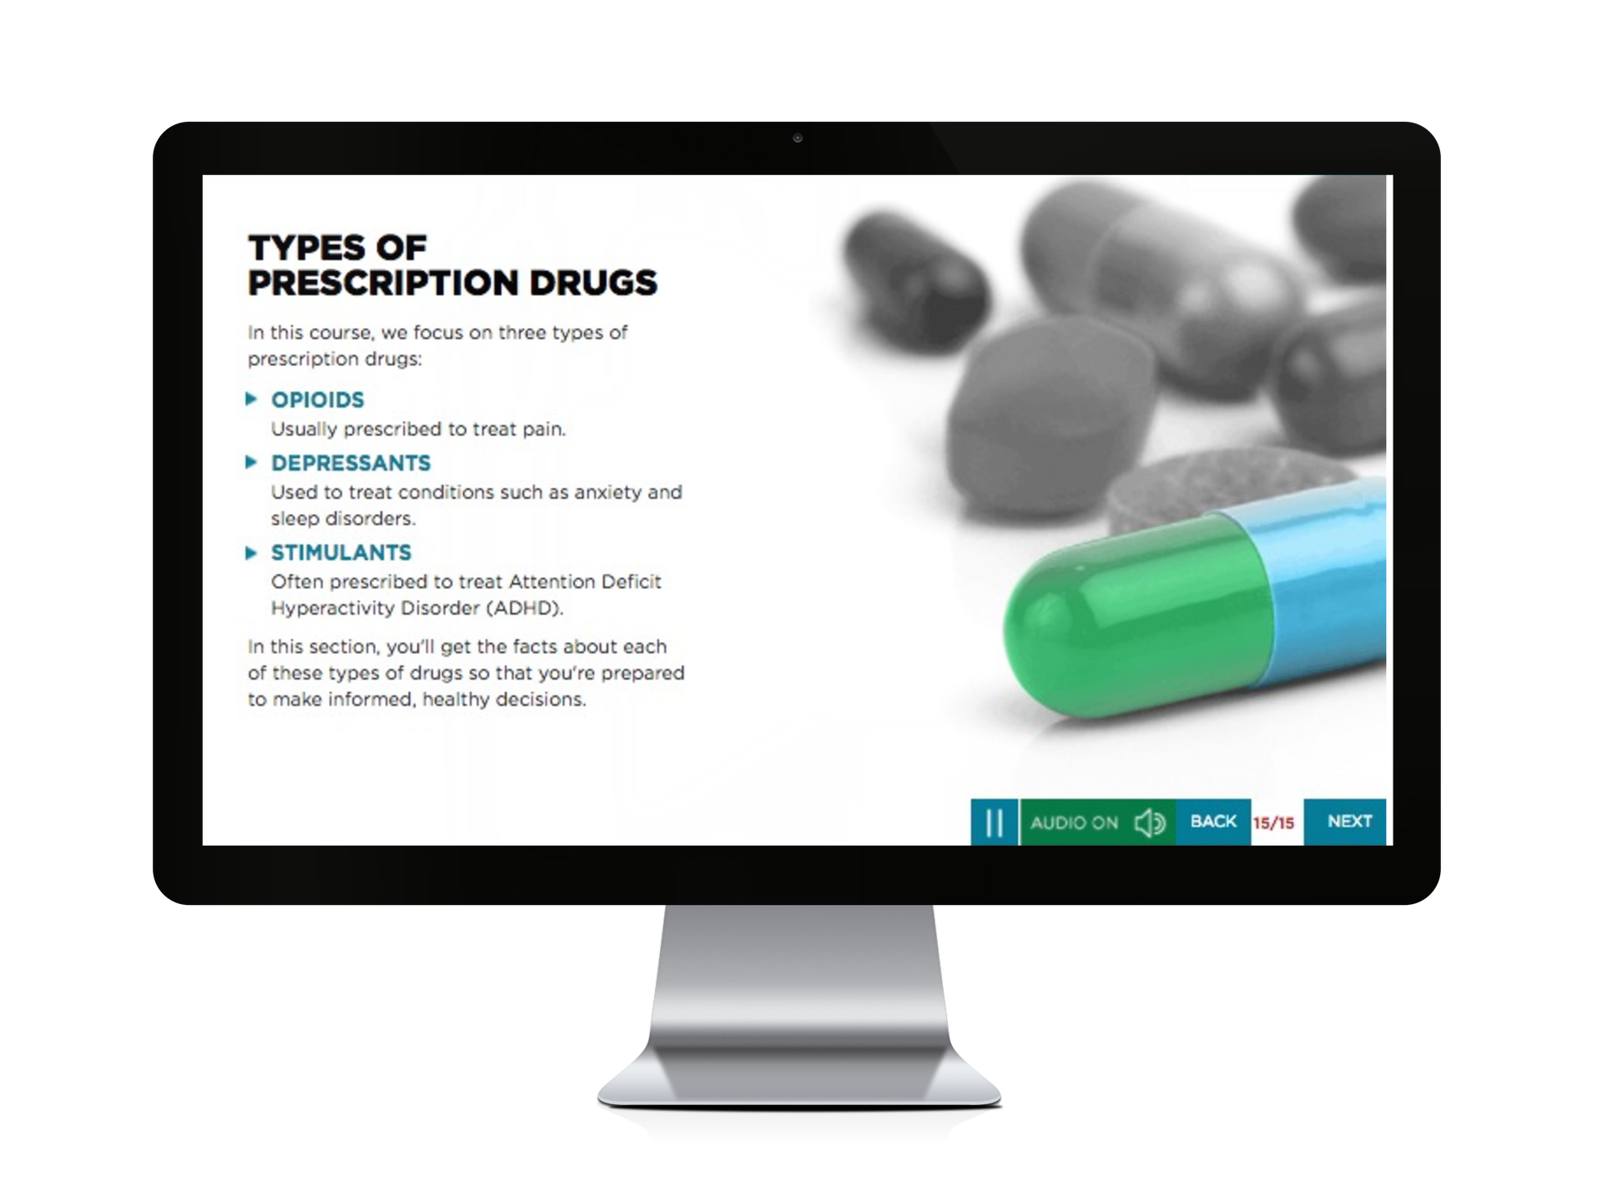
About Mental Well-Being for Students
The Benefits of Working
with Vector Solutions
Mental Well-Being for Students Course
Objectives
Proven Efficacy
Nine independent studies have been published demonstrating the efficacy of Vector Solutions’ online programs. Our approach improves knowledge, attitudes, and behaviors.
Reduce the stigma
surrounding mental health and promote conversations about well-being
True Expertise
Our team includes public health professionals, administrators from student affairs, campus prevention offices, legal experts, and more. Extend your team by partnering with ours.
Introduce strategies
for approaching challenges, including self-management, self-advocacy, and building a support system
Beyond Compliance
Our online programs are built by prevention and compliance experts to meet and exceed requirements from Title IX, Clery Act, and EDGAR part 86.
Empower learners
to support peers in crisis situations
Data Driven
Our data and analytics provide real-time access to attitudinal and behavioral data from your unique populations, and national benchmarks to assess needs and strengths.
Connect learners
with campus-based support and local resources

