Slide 1
Sexual Assault Prevention for Undergraduates
Georgia Institute of Technology
Impact Report | 2023–2024 Academic Year

Slide 2

Dear Georgia Institute of Technology Partner,
I am pleased to provide your 2023-24 Impact Report for Sexual Assault Prevention for Community College. This year’s report includes key insights from your Vector Solutions program, demonstrating the impact of your investment in the health, safety, and well-being of your students.
As a public health professional, I think often about prevention as a process – not a program. We’ve built our courses and surveys to align with best practices and support you in the prevention process. Here are some guiding points and questions to help you make the most of your Vector data:
When it comes to safety and wellness, scale and impact matters. How are you highlighting the reach and results of your online programming to garner visibility and support for your work? Leading institutions share their data in cabinet-level briefs, in Annual Security Reports, in marketing and PR efforts, and even to support accreditation.
Our courses and surveys address a range of factors that influence behavior change: knowledge and awareness, attitudes and beliefs, perceived outcomes, personal and social norms, behavioral skills, perceived behavioral control, and cues to action. How can these data inform where to focus additional resources (and where to pull back)?
Most learners have incredibly positive attitudes and behaviors related to issues of wellness and safety, even before training. Overcoming *inaction* of those who want to make a difference in unsafe situations can be even more powerful than focusing on individual actions of those committing harm. How can you leverage your data to elevate and empower the “healthy majority” as changemakers?
Are you adding custom survey questions in your courses? Are you using disaggregated survey data to conduct additional analyses (e.g., exploring differences based on demographic sub-groups)? *
The scalable reach and data from your Vector Solutions programs can be a springboard to more informed and effective engagement with your community. As you delve into the insights in this Impact Report, consider strategic ways to utilize these data to strengthen the prevention process at your institution.
Your partner in prevention,
Rob Buelow
VP and General Manager, Education
Vector Solutions
* Reach out to your Vector Solutions representative with questions about capabilities available to your institution.

Slide 3
Table of Contents
How to Use This Report | 4
Executive Summary | 5
Impact Snapshot | 6
SAPU and Your Students | 10
Knowledge Gain | 11
Knowledge Gains and Learner Impact | 12
Healthy Relationships and Consent | 13
Supporting Survivors | 14
Sexual Assault Prevention on Your Campus | 15
Engaging the Healthy Majority | 16
Personal Experiences by Gender Identity | 17
Bystander Behaviors by Gender Identity – He / Him | 18
Bystander Behaviors by Gender Identity – She / Her | 19
Social Norms for Behavior | 20
Campus Climate | 21
Community Readiness | 22
Appendix – Student Demographics | 23
Supplemental Information | 26
Prevention Framework | 27
About Sexual Assault Prevention for Undergraduates | 28
Sexual Assault Prevention for Undergraduates Course Map | 29

Slide 4

How To Use This Report
Peer Institution Benchmarks
Campus Prevention Network Framework Tips
Sharable Snapshot
For select data points in this report, you will see comparisons to peer institution benchmarks. These peer institutions are similar to yours in size and public or private status. Georgia Institute of Technology is a public institution with 10,000 to 19,999 students, so your benchmarks reflect that particular group of schools.
The Campus Prevention Network Framework for Prevention describes the elements of effective prevention efforts: Institutionalization, Critical Processes, Policy, and Programming. Throughout this report, you will find Tips and further research related to these prevention elements.
At the end of this report, you will find a snapshot of select data from your report. This snapshot is designed to be shared with other stakeholders at your institution. We hope that you will print these pages out and pass them along to your Vice President of Student Affairs, Provost, or other members of your team.
This report provides key insights from your Sexual Assault Prevention for Undergraduates data. We encourage you to explore the data in the report, think about how you can use it to inform prevention efforts across your institution, and share it with others on your campus.
To help you make the most of this report, we have included benchmarks to help you understand where you stand relative to peer institutions, provided recommendations throughout the report tied to a framework for prevention, and included a sharable snapshot of your data at the end of this report.
For deeper insights, the administrator site provides real-time access to your data, in both graphical and raw data formats.
Data in this Report
Data Accuracy
The data included in this report were collected between June 1, 2023 and February 26, 2024. Insights and analyses in this report are based on your students' responses to Pre-Course, Post-Course, and Follow-Up (Part Two) Surveys. Overall, 3,043 students completed pre-course surveys, 2,813 completed post-course surveys, and 2,058 completed follow-up surveys.
While learners are encouraged to answer all questions honestly and reminded that their responses are stored confidentially, all survey questions are optional, and all data are self-reported. However, in our analysis of the responses, we find the data to be accurate, valid, and reliable. There is consistency in the data from student cohorts over the years at specific institutions, and our survey data correlates with external sources of information on these topic areas at the national and institutional level for college students.

Slide 5
Executive Summary
This school year,
4,390 Georgia Institute of Technology students took part in Sexual Assault Prevention for Undergraduates (SAPU) from June 1, 2023 to February 26, 2024. This course, developed by prevention education and compliance experts, uses relatable scenarios and interactive elements to provide students with strategies for healthy behavior and skills to support bystander intervention.
Course Impact
SAPU is designed to equip your students with knowledge and skills to support healthier decisions related to romantic relationships, sexual interactions, consent, and supporting peers on their campus.
When it comes to skills, 82% of Georgia Institute of Technology students agreed that SAPU helped them identify characteristics of healthy and unhealthy relationships, and 82% reported that the education increased their confidence in their ability to intervene when they witnessed concerning behavior.
Behavioral Intentions & Norms
Change is driven, in part, by an individual’s perception of the social environment surrounding behavior — the community norms.
Most students taking SAPU report healthy attitudes and behaviors related to sex and relationships. This includes 88% of students who say they would refrain from sexual activity if the other person was incapacitated, but only 67% of those same students believe their peers would do the same.
Among students at Georgia Institute of Technology who took SAPU, 45% agreed that they could play a role in preventing sexual assault on their campus. And a substantial number of your students, after taking SAPU, reported that they knew how to report a sexual assault at their school. Further, 83% expressed an awareness of support resources related to sexual assault and relationship violence at your institution.
Your Sexual Assault Prevention for Undergraduates Impact Report includes detailed information about how your students think, feel, and behave in romantic and sexual relationships. This data can be invaluable in guiding your prevention programming for maximum impact.

Slide 6
Sexual Assault Prevention for Undergraduates
Impact Snapshot

Slide 7

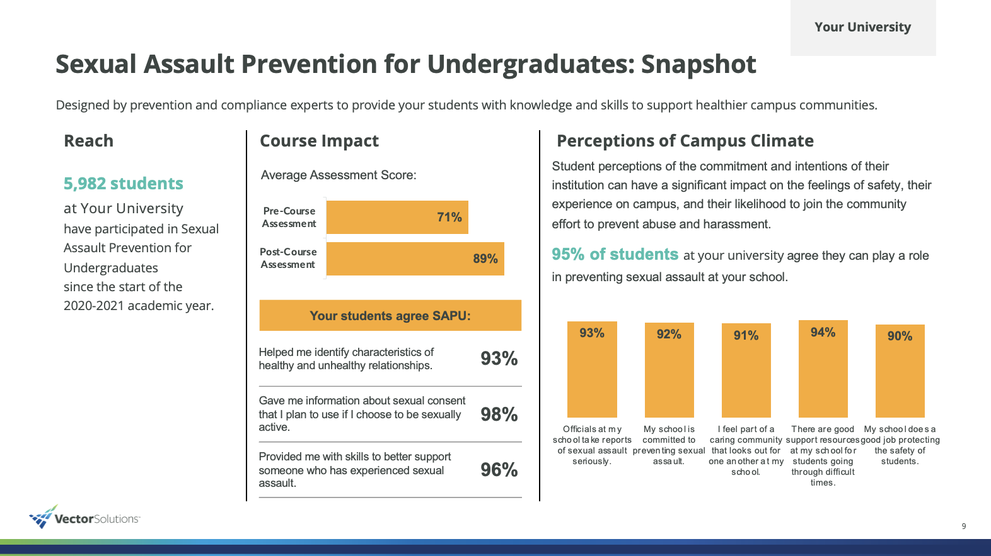
Impact Snapshot
In order to make the content of this report easier to share with your colleagues and stakeholders, we have included a Snapshot section that highlights and visually displays the most salient data points from the full report.
This can help your data get more traction and increase interest in the full report and the Sexual Assault Prevention for Undergraduates program at large.
We recommend excerpting this Snapshot section from the full report and sharing with stakeholders, colleagues, and students who might be interested in the impact of the SAPU program but have less direct experience in prevention work.

Slide 8
Sexual Assault Prevention for Undergraduates: Snapshot
Georgia Institute of Technology
Designed by prevention and compliance experts to provide your students with knowledge and skills to support healthier campus communities.
Reach
Course Impact
Perceptions of Campus Climate
4,390 students
at Georgia Institute of Technology took part in Sexual Assault Prevention for Undergraduates from June 1, 2023 to February 26, 2024.
Students increased their prevention knowledge, and their skills associated with healthier behavior.
Student perceptions of the commitment and intentions of their institution can have a significant impact on the feelings of safety, their experience on campus, and their likelihood to join the community effort to prevent abuse and harassment.
45% of students at Georgia Institute of Technology agree they can play a role in preventing sexual assault at your school.
Your students agree that SAPU:
Helped me identify characteristics of healthy and unhealthy relationships. | 82%
Gave me information about sexual consent that I plan to use if I choose to be sexually active. | 83%
Provided me with skills to better support someone who has experienced sexual assault. | 83%
Notes:
Assessment
|post_avg|
|pre_avg|
>>>>>>>>
Campus
|sapu2_6a|
|sapu2_6b|
|sapu2_6c|
|sapu2_6d|
|sapu2_6e|

Slide 9
Sexual Assault Prevention for Undergraduates: Snapshot
Georgia Institute of Technology
Bystander Intervention
Bystander Intervention Scenarios
Preferred Bystander Behaviors
She / Her
1 | Asking the person who you’re concerned about if they need help.
2 | Following up later to check in with the person who you were concerned about.
3 | Finding the friends of those involved and asking them for help.
Proactive bystander behaviors —stepping in directly or engaging other observers indirectly — are some of the most important ways students can support and build a healthy campus environment.
SAPU helps students build their bystander skills. Georgia Institute of Technology can use this information to continue to develop those skills as part of a healthy campus community.
He / Him
1 | Asking the person who you’re concerned about if they need help.
2 | Stepping in and separating the people involved in the situation.
3 | Finding the friends of those involved and asking them for help.
Tip
Research has shown that male-identifying students may be more likely to engage in active, direct bystander behaviors than their female-identifying peers. While it is encouraging to know that students are interested in stepping in to help peers, not every situation calls for a specific type of response. Students should be encouraged to engage in a wide range of behaviors and helped to understand which strategies should be employed for maximum effectiveness.
82% of students at Georgia Institute of Technology agree that SAPU made them more confident in their ability to intervene when they see concerning behavior.
Notes:
|sapu3_f1|
|sapu3_m1|
|sapu3_f2|
|sapu3_m2|
|sapu3_f3|
|sapu3_m3|
|sapu3_f4|
|sapu3_m4|

Slide 10
SAPU and Your Students
Impact at Georgia Institute of Technology

Slide 11
Knowledge Gain
Georgia Institute of Technology
Assessments in SAPU, which students take immediately before and after the course, are designed to measure their comprehension and knowledge of topics related to sexual and gender-based violence.
Programming Tip
Where are your students knowledgeable and where is there room to learn more? SAPU is intended to provide foundational knowledge and skills that can be built upon. Knowledge data can inform which content areas should be built out or reinforced as part of your ongoing prevention efforts.
Notes:
|pre_1|
|post_1|
|pre_2|
|post_2|
|pre_3|
|post_3|
|pre_4|
|post_4|
|pre_5|
|post_5|

Slide 12
Knowledge Gains and Learner Impact
Georgia Institute of Technology
After taking SAPU, students were asked to reflect on the course experience and share how it impacted their awareness, knowledge, and confidence to help them make healthier decisions and support their peers in the future.
Your students reported that SAPU:
Made me more confident in my ability to intervene when I see concerning behavior. | 82%
Helped me identify characteristics of healthy and unhealthy relationships. | 82%
Taught me where to find resources for sexual assault and abusive relationships at my school. | 82%
Provided me with skills to better support someone who has experienced sexual assault. | 83%
The course increased my understanding of school policies related to the issues of consent, sexual assault, relationship violence, sexual harassment, and stalking. | 83%
Gave me information about sexual consent that I plan to use if I choose to be sexually active. | 83%
Programming Tip
How can you reinforce students’ skills and feelings of self-efficacy throughout the year and over your students’ college careers? Ongoing training — both annually online and through in-person opportunities such as workshops, role-playing, peer conversations — can reinforce key information, allow students to practice their skills, and build confidence.
Note: Percentages represent the share of students who chose “agree” or “strongly agree” in response to these statements in the Post-Course Survey.

Slide 13
Healthy Relationships and Consent
Georgia Institute of Technology
In addition to providing important baseline knowledge, SAPU helps students build the skills and attitudes they can use to support a healthy community. These include identifying unhealthy situations, supporting friends, and modeling attitudes that reflect healthy community norms.
Programming Tip
Research has shown that young adults are likely to overestimate their own abilities, particularly when it comes to areas where they have not had to employ those skills. This leads to some students feeling overconfident in the Pre-Course Survey, but after taking the course, they may acquire a more nuanced perspective, which can help explain the flat or slight decrease in healthy responses pre-to-post course that you may see in the chart on this page.
Notes:
|sapu1_1e|
|sapu2_1e|
|sapu1_1d|
|sapu2_1d|
|sapu1_1ab|
|sapu2_1ab|
|sapu1_1a|
|sapu2_1a|

Slide 14
Supporting Survivors
Georgia Institute of Technology
Maintaining a healthy community requires supporting community members who experience sexual and gender-based violence. SAPU helps students identify how to access to support and reporting resources, ways to intervene in unhealthy situations and support others, and build confidence to address attitudes of victim blaming when a sexual assault occurs.
Critical Processes Tip :
To learn more about what your colleagues are doing on their campuses, what is being shown to work in research, and to connect with others trying to prevent sexual assault and domestic violence in higher education, join the Campus Prevention Network at: https://www.vectorsolutions.com/networks/campus-prevention-network/
Notes:
|sapu1_1q|
|sapu2_1q|
|sapu1_1b|
|sapu2_1b|
|sapu1_1g|
|sapu2_1g|
|sapu1_1o|
|sapu2_1o|
|sapu1_1j|
|sapu2_1j|

Slide 15
Sexual Assault Prevention On Your Campus
Data and Insights From Students at Georgia Institute of Technology

Slide 16
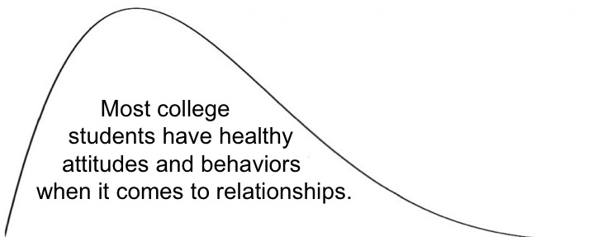
Engaging the Healthy Majority
Georgia Institute of Technology
SAPU data shows that most students have healthy attitudes and behaviors related to relationships. Although it is often tempting to focus on the relatively small group of “unhealthy” students, engaging the “healthy majority” can create a culture of care and accountability that helps build a safe community.
In addition to reporting on the personal experiences of your students, the following pages highlight topics that can help you understand how to engage and bolster the healthy majority on your campus: bystander intervention, social norms, perceptions of campus climate, and readiness to engage in prevention efforts on your campus.
Most college
students have healthy
attitudes and behaviors
when it comes to relationships.
Healthy Attitudes and Behaviors
Unhealthy Attitudes and Behaviors
Critical Processes Tip
Reflect on the share of your sexual assault prevention programming and policies that is focused on supporting the healthy majority, compared to addressing or disciplining the unhealthy minority. Are there areas where you could supplement or expand efforts that develop a positive culture on your campus?

Slide 17
Personal Experiences By Gender Identity
Georgia Institute of Technology
Some of your students arrive on campus having had personal experience with sexual assault, relationship violence, or stalking. Others may have these experiences after they become members of your community.
 | She / Her |  | He / Him
 | Before | After | Before | After
Sexual Assault | 3.02% | 0.32% | 1.01% | 0.11%
Relationship Violence | 1.22% | 0.11% | 0.96% | 0.16%
Stalking | 4.71% | 1.00% | 1.22% | 0.32%
Sexual Assault Has someone ever had unwanted sexual contact with you?
Relationship Violence Has a current or former partner ever abused or threatened to abuse you? (e.g. verbally, physically, sexually, emotionally, financially)
Stalking Have you experienced repeated and unwanted attention, harassment, or other form of contact from another person that has made you feel afraid?
Note: Before and After each include those who chose “both before and after.”
Note
Vector Solutions recognizes and appreciates that everyone may not identify with either of these two gender identities. While this report presents comparisons between students who identify as male or female, the survey presented additional non-binary options for students to self-identify including an option to write-in how they identify. To examine attitudes, experiences, and behaviors of additional gender identities, you can access your institution’s data through the administrator site.
Critical Processes Tip
Notice how personal experiences may be different for male-identifying and female-identifying students. Think about what other demographic characteristics may have an influence on personal experiences at your institution, including race, ethnicity, group membership, year in school, sexual orientation, etc..

Slide 18
Bystander Behaviors by Gender Identity – He / Him
Georgia Institute of Technology
Proactive bystander behaviors — stepping in directly or engaging other observers indirectly — are some of the most important ways students can support and build a healthy campus environment. On the right is a summary of when male-identifying students on your campus have intervened, and their preferred strategies for doing so.
Bystander Intervention Scenario
I spoke up when I heard someone saying something I found offensive or demeaning. | 84%
I expressed concern when I saw a person exhibiting abusive behavior toward their partner. | 67%
I helped someone get support or find resources when they told me about an unwanted sexual experience. | 62%
I intervened when I saw someone trying to take advantage of someone else sexually. | 67%
Programming Tip
Research has shown that male-identifying students may be more likely to engage in active, direct bystander behaviors than their female-identifying peers. While it is encouraging to know that students are interested in stepping in to help peers, not every situation calls for a specific type of response. Students should be encouraged to engage in a wide range of behaviors and helped to understand which strategies should be employed for maximum effectiveness.
Note: Percentages represent students who indicated they have been present in the described scenario.
Preferred Bystander Behaviors
Your male-identifying students tend to express confidence in engaging in the following three behaviors if they observe a potential sexual assault situation:
Asking the person who you’re concerned about if they need help.
Stepping in and separating the people involved in the situation.
Finding the friends of those involved and asking them for help.

Slide 19
Bystander Behaviors by Gender Identity – She / Her
Georgia Institute of Technology
Understanding how your students prefer to stand up for one another can help you develop strategies to reinforce those strengths, and to help students feel more supported when they do stand up. Below are the preferred bystander behaviors for female-identifying students on your campus.
Bystander Intervention Scenario
I spoke up when I heard someone saying something I found offensive or demeaning. | 83%
I expressed concern when I saw a person exhibiting abusive behavior toward their partner. | 85%
I helped someone get support or find resources when they told me about an unwanted sexual experience. | 79%
I intervened when I saw someone trying to take advantage of someone else sexually. | 82%
Programming Tip
Given that students with different identities report different experiences, attitudes, and behaviors, it is important to consider additional resources that may be directed towards specific student populations on campus. These efforts may focus on high-risk student sub-groups, and we also suggest using targeted supplemental education and resources for under-represented identities to help all students feel safe and welcome on campus.
Note: Percentages represent students who indicated they have been present in the described scenario.
Preferred Bystander Behaviors
Your female-identifying students tend to express confidence in engaging in the following three behaviors if they observe a potential sexual assault situation:
Asking the person who you’re concerned about if they need help.
Following up later to check in with the person who you were concerned about.
Finding the friends of those involved and asking them for help.

Slide 20
Social Norms for Behavior
Georgia Institute of Technology
An individual is more likely to act in a particular way if they believe their actions will be supported by their peers. However, research shows that there is often a gap between what an individual thinks they would do (the “actual norm”), and what they believe their peers would do (the “perceived norm”). This is called the ”norms gap.” SAPU aims to decrease the norms gap among your students so they will be more likely to engage in pro-social behaviors on campus.
Norms Gap, Before Course
20 points
20 points
18 points
32 points
10 points
Programming Tip
Feelings of not being supported by other members of a social group or community are likely to be an obstacle to intervening, standing up to concerning behavior, and supporting friends and peers. You can examine the norms gap between subgroups by using data from your administrator site and looking into which groups could use additional training and support to close the norms gap.
Norms Gap, After Course
12 points
12 points
12 points
21 points
8 points
Notes:
BeforeCourse
|sapu1_1c|
|sapu1_1r|
|sapu1_1m|
|sapu1_1n|
|sapu1_1t|
|sapu1_1p|
|sapu1_1f|
|sapu1_1aa|
|sapu1_1s|
|sapu1_1l|
>>>>>>>>>>>>>>>>>>>>>
AfterCourse
|sapu2_1c|
|sapu2_1r|
|sapu2_1m|
|sapu2_1n|
|sapu2_1t|
|sapu2_1p|
|sapu2_1f|
|sapu2_1aa|
|sapu2_1s|
|sapu2_1l|

Slide 21
Campus Climate
Georgia Institute of Technology
After completing the course, students answered a series of questions related to the climate around sexual assault at their school. This information can help you understand the degree to which your institution’s sexual assault prevention efforts are impacting student perceptions of the campus environment and, in turn, the institution's commitment to preventing harm.
Institutionalization Tip
Students’ perceptions of the commitment and intentions of their institution can have a significant impact on their feelings of safety and support, their experience while on campus, and their likelihood to join the community effort to prevent abuse and harassment. These may be very valuable data points to share with administrators to show how students are feeling about the climate at your institution and for senior leaders to consider when communicating publicly about the expectations of students in their community.
Notes:
|sapu2_6a|
|sapu2_6ap|
|sapu2_6b|
|sapu2_6bp|
|sapu2_6c|
|sapu2_6cp|
|sapu2_6d|
|sapu2_6dp|
|sapu2_6e|
|sapu2_6ep|

Slide 22
Community Readiness
Georgia Institute of Technology
After completing the course, students answered questions about their readiness to address sexual assault at their school — from identifying sexual assault as an issue worthy of their attention, to getting personally involved in prevention efforts.
Programming Tip
These categories from left to right represent a continuum of readiness to support prevention efforts on your campus. While most students come to school with a healthy and open mindset, it is important to consider how prevention efforts are influencing all students across this continuum and how we can pull those from the least desirable categories towards a more positive perspective towards community at your institution.
Notes:
|sapu2_3a_1|
|sapu2_3ap_1|
|sapu2_3a_2|
|sapu2_3ap_2|
|sapu2_3a_3|
|sapu2_3ap_3|
|sapu2_3a_4|
|sapu2_3ap_4|
|sapu2_3a_5|
|sapu2_3ap_5|

Slide 23
Sexual Assault Prevention for Undergraduates
Appendix – Student Demographics

Slide 24
Student Demographics
The following is a summary of the demographics of students who participated in SAPU from June 1, 2023 to February 26, 2024. Demographic information is self-reported by students as part of the Pre-Course Survey. All questions are optional, and students may choose not to share demographic information.
 | Heterosexual/Straight | 80% |  | Bisexual | 8%
 | Gay | 2% |  | Lesbian | 2%
 | Questioning | 3% |  | Other responses | 6%
 | She / Her | 42% |  | They / Them | 3%
 | He / Him | 55% |  | Other | 0%
Note: ‘Other responses’ reflects the number of students who selected Asexual or Queer
Note: Both of these questions allow respondents to select more than one item, so either total may exceed 100%.
Do you identify as trans (e.g., transgender, transsexual, a person with transitioning sex or gender history, etc.)?
Yes | 1% | No | 95% | Not sure | 1% | Prefer not to answer | 3%
Notes:
GenderIdentity
|fem|
|mal|
|they|
|other|
>>>>>>>>>>>>>>>>>
SexualOrientation
|het|
|bis|
|gay|
|les|
|ques|
|otr|

Slide 25
Student Demographics (continued)
 | 17 Years or younger | 10% |  | 18 Years | 70%
 | 19 Years | 13% |  | 20 Years | 3%
 | 21+ Years | 3%
Note: Respondents could choose more than one option, so total may exceed 100%.
Notes:
Ethnicity
|black|
|white|
|asian|
|hispanic|
|native|
|american|
|middleeast|
|others|
>>>>>>>>>>>>>>>>>>>>>
Age
|sev|
|eig|
|nin|
|twe|
|two|

Slide 26
Sexual Assault Prevention for Undergraduates
Supplemental Information

Slide 27
The Prevention Framework
Policy
Institutionalization
Critical Processes
Programming
Prevention training, programs and communication strategies that maximize engagement and drive impact
The Prevention Framework, developed by Vector Solutions’ Campus Prevention Network, defines the elements of a comprehensive approach to prevention, and the ways in which those elements build to an effective prevention program.
The values and expectations of the organization, and the-system of accountability to uphold and enforce them
Using goal setting, strategic planning, and data analysis to inform and evaluate prevention work
System-wide buy-in, visible commitment, and investment in effective prevention initiatives

Slide 28
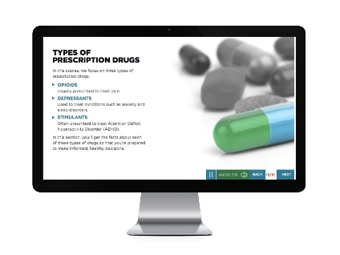
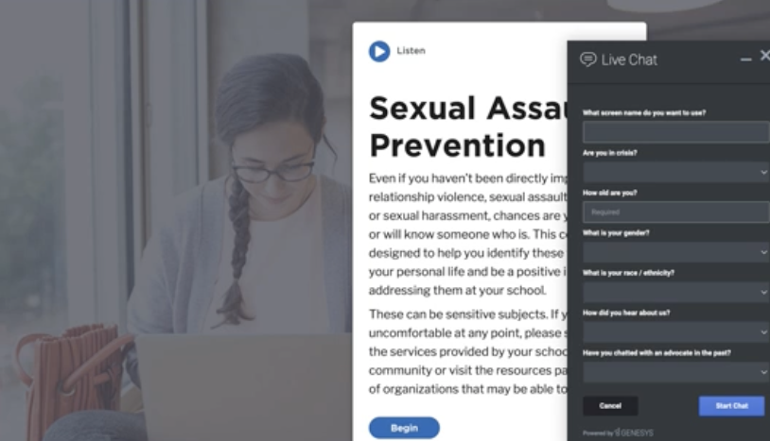
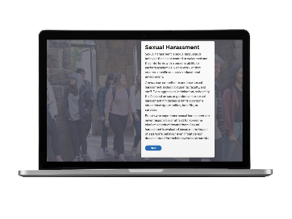
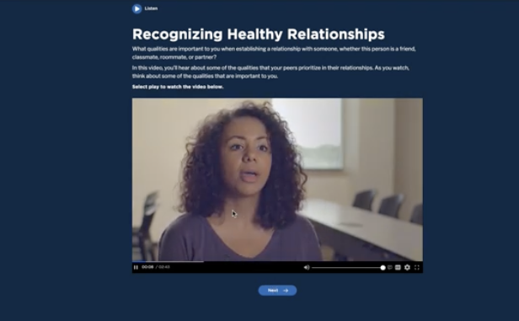
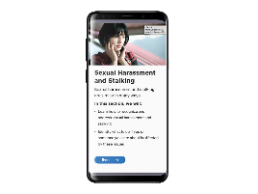
About Sexual Assault Prevention for Undergraduates
The Benefits of Working
with Vector Solutions
Sexual Assault Prevention for
Undergraduates
Proven Efficacy
Nine independent studies have been published demonstrating the efficacy of Vector online programs. Our approach improves knowledge, attitudes, and behaviors.
Helps meet or exceed
Title IX and Clery Act requirements.
True Expertise
Our team includes public health professionals, administrators from student affairs, campus prevention offices, legal experts, and more. Extend your team by partnering with ours.
Developed in collaboration
with leading prevention experts and researchers.
Beyond Compliance
Our online programs are built by prevention and compliance experts to meet and exceed requirements from Title IX, Clery Act, and EDGAR part 86.
Informed by Emerging Research
on evidence-based practice (e.g., social norms approach, bystander intervention).
Data Driven
Our data and analytics provide real-time access to attitudinal and behavioral data from your unique populations, and national benchmarks to assess needs and strengths.
Shown to have impact
on student attitudes and intentions at a campus-level in peer-reviewed publication.

Slide 29
Sexual Assault Prevention for Undergraduates Course Map
Part 1 | 1. Introduction Welcome Sexual Assault Prevention What Do You Think? Your Voice, Your Experience | Pre-Course Survey | Pre-Course Assessment | 2. Values, Identities, & Relationships Who am I? Our Unique Identities Our Values Local Support Information | 2. Values, Identities, & Relationships Who am I? Our Unique Identities Our Values Local Support Information | Pre-Course Quiz | 3. Identities and Stereotyping Why are Gender Stereotypes Harmful? What Can You Do About Harmful Language? Title IX of the Education Amendments Act of 1972 Sexual Misconduct Policy
 | 4. Our Values and Relationships Recognizing Healthy Relationships Recognizing Relationship Abuse Federal and State Laws: Relationship Violence Resources Understanding the Warning Signs of Digital Abuse Using Strategies to Stay Safe |  | 5. Consent, Coercion, & Bystander Intervention Consent: Part of Healthy Communication What Does Consent Look Like? Understanding Consent Coercion What Does Coercion Look Like? Alcohol and Coercion State Law: Consent Federal and State Laws: Sexual Assault |  |  | 5. Consent, Coercion, & Bystander Intervention Consent: Part of Healthy Communication What Does Consent Look Like? Understanding Consent Coercion What Does Coercion Look Like? Alcohol and Coercion State Law: Consent Federal and State Laws: Sexual Assault | 6. Sexual Harassment and Stalking Sexual Harassment Forms of Sexual Harassment Responding to Sexual Harassment Stalking Federal and State Laws: Stalking
 | 7. Reporting and Responding Impact of Trauma How Identities May Impact Survivors’ Experiences Responding to Survivors National Resources, School and Local Resources Student Engagement Survey Reporting Reporting Options and Processes State Law: Legal Protections Reporting Resources |  | Post-Course Assessment and Post-Course Survey |  | 8. Conclusion Course Summary | 8. Conclusion Course Summary
Part 2 | Intersession |  | Follow-up Survey (Part Two)

