Slide 1



Georgia Institute of Technology
Sexual Assault Prevention for Graduate Students
Impact Report
2024 – 2025 Academic Year

Slide 2

Dear Georgia Institute of Technology Partner,
I am pleased to share your 2024-25 Impact Report for Sexual Assault Prevention for Graduate Students. This year’s report highlights the continued impact of your investment in fostering the health, safety, and well-being of your students and employees.
The socio-political landscape in higher education is rapidly evolving, placing even greater importance on investing in programs that make a difference in your community. And as financial pressures increase and expectations for accountability grow, leveraging data to make informed decisions is more critical than ever.
At Vector Solutions, we view prevention not as a one-time program but as an ongoing process. The insights within this report are designed to help you both demonstrate and drive meaningful change on your campus. Here are some strategic considerations to help maximize the value of your data:
Making the Case for Impact: In a competitive higher education environment, showcasing the reach and outcomes of your prevention programs is essential. How are you leveraging data to gain support for your initiatives—whether through cabinet-level reports, accreditation efforts, or external communications?
Prioritizing Resource Allocation: Our courses and surveys explore key drivers of behavior change, from knowledge and attitudes to social norms and behavioral skills. How can these data points guide decisions about where to invest resources and where to scale back?
Empowering the Healthy Majority: Most learners already hold positive attitudes and behaviors toward wellness and safety. How can you use this data to amplify their voices and encourage them to become active changemakers at your institution?
Unlocking Deeper Insights: Are you fully utilizing your data by incorporating custom survey questions or conducting disaggregated analyses? These approaches can help you uncover nuanced needs and strengths in your community.
The insights in this report not only reflect your commitment to prevention but also highlight its role in enhancing institutional performance, whether it’s fostering an engaged and productive workforce or driving student success outcomes across the lifecycle. These outcomes underscore the strategic value of prevention in advancing institutional goals.
As you explore this year’s findings, I encourage you to think about how these insights can inform and strengthen your ongoing prevention efforts. By prioritizing data-driven decision-making, your institution is positioned to thrive in this dynamic, challenging, and all-important time for higher education.
Your partner in prevention,
Rob Buelow
VP and General Manager, Education
Vector Solutions
2

Slide 3


How to Use This Report | 4
Executive Summary | 5
Impact Snapshot | 6
SAPG and Your Students | 10
Knowledge Gain | 11
Course Impact | 12
Healthy Relationships and Consent | 13
Supporting Survivors | 14
Sexual Assault Prevention on Your Campus | 15
Engaging the Healthy Majority | 16
Personal Experiences, Females and Males | 17
Bystander Behaviors, Females | 18
Bystander Behaviors, Males | 19
Social Norms for Behavior | 20
Campus Climate | 21
Community Readiness | 22
Appendix – Student Demographics | 23
Supplemental Information | 26
Prevention Framework | 27
About Sexual Assault Prevention for Graduate Students | 28
Table of Contents
3

Slide 4
How To Use
This Report
Peer Institution Benchmarks
Campus Prevention Network Framework Tips
For select data points in this report, you will see comparisons to peer institution benchmarks. These peer institutions are similar to yours in size and public or private status. Georgia Institute of Technology is a Public institution with 10,000 to 19,999 students, so your benchmarks reflect that particular group of schools.
The Campus Prevention Network Framework for Prevention describes the elements of effective prevention efforts: Institutionalization, Critical Processes, Policy, and Programming. Throughout this report, you will find tips and further research related to these prevention elements.
This report provides key insights from your Sexual Assault Prevention for Graduate Students (SAPG) course survey and assessment data. We encourage you to explore the data in the report, think about how you can use it to inform prevention efforts across your institution, and share it with others on your campus.
To help you make the most of this report, we have included benchmarks to help you understand where you stand relative to peer institutions, provided recommendations throughout the report tied to a framework for prevention, and included a sharable snapshot of your data at the beginning of this report.
For deeper insights, your Vector Solutions administrator site provides real-time access to your survey data, in both graphical and raw data formats.​
About the Data in This Report
Type of Data
This report includes data from student surveys: Pre-Course Surveys taken immediately before the course; Post-Course Surveys taken immediately after the course; and Follow-Up Surveys (Part Two) taken after an intersession period (typically 30-45 days following course completion). Overall, 2,708 of your students completed the Pre-Course Survey, 2,474 completed the Post-Course Survey, and 2,621 completed the Follow-Up Survey (Part Two).
Data Accuracy
All data are self-reported, but, in our analysis of responses, we find the data to be accurate, valid, and reliable. There is great consistency in the data from student cohorts over the years at specific institutions and our survey data correlates with external sources of information on these topic areas at the national and institutional level for college students. ​
Important Note About Your 2024-2025 Data
The data included in this report were collected between June 1, 2024 and February 25, 2025. Please note the following:
While learners are encouraged to answer all survey questions honestly and are notified that their responses are stored confidentially, they are reminded that all survey questions are optional.
Impact Reports are based on data from course surveys and assessments only (not course completions).
A low (n < 50) number of responses to the Follow-Up Survey (Part Two) can result in there being extreme (very high or low) or no (if n = 0) data present on certain slides.
4

Slide 5


Executive
Summary
This school year,
2,708 Georgia Institute of Technology students completed surveys in Sexual Assault Prevention for Graduate Students (SAPG) from June 1, 2024 to February 25, 2025. This course, developed by prevention education and compliance experts, uses relatable scenarios and interactive elements to provide students with strategies for healthy behavior and skills to support bystander intervention.
Course Impact
SAPG is designed to equip your students with knowledge and skills to support healthier decisions related to romantic relationships, sexual interactions, consent, and supporting peers on their campus.
Georgia Institute of Technology students increased their knowledge of topics related to sexual assault prevention by 4%. When it comes to skills, 90% of your students agreed that SAPG helped them identify characteristics of healthy and unhealthy relationships, and 88% reported that the education increased their confidence in their ability to intervene when they witnessed concerning behavior.
Behavioral Intentions & Norms
Change is driven, in part, by an individual’s perception of the social environment surrounding behavior — the community norms.
Most students taking this course report healthy attitudes and behaviors related to sex and relationships. This includes 95% of students who say they would refrain from sexual activity if the other person was incapacitated, while 78% of those same students believe their peers would do the same.
Among students at Georgia Institute of Technology who took SAPG, 46% agreed that they could play a role in preventing sexual assault on their campus. And a substantial number of your students, after taking SAPG, reported that they knew how to report a sexual assault at their school. Further, 89% felt that your institution offered good resources for students going through difficult times.
Your Sexual Assault Prevention for Graduate Students Impact Report includes detailed information about how your students think, feel, and behave in romantic and sexual relationships. This data can be invaluable in guiding your prevention programming for maximum impact.

Slide 6
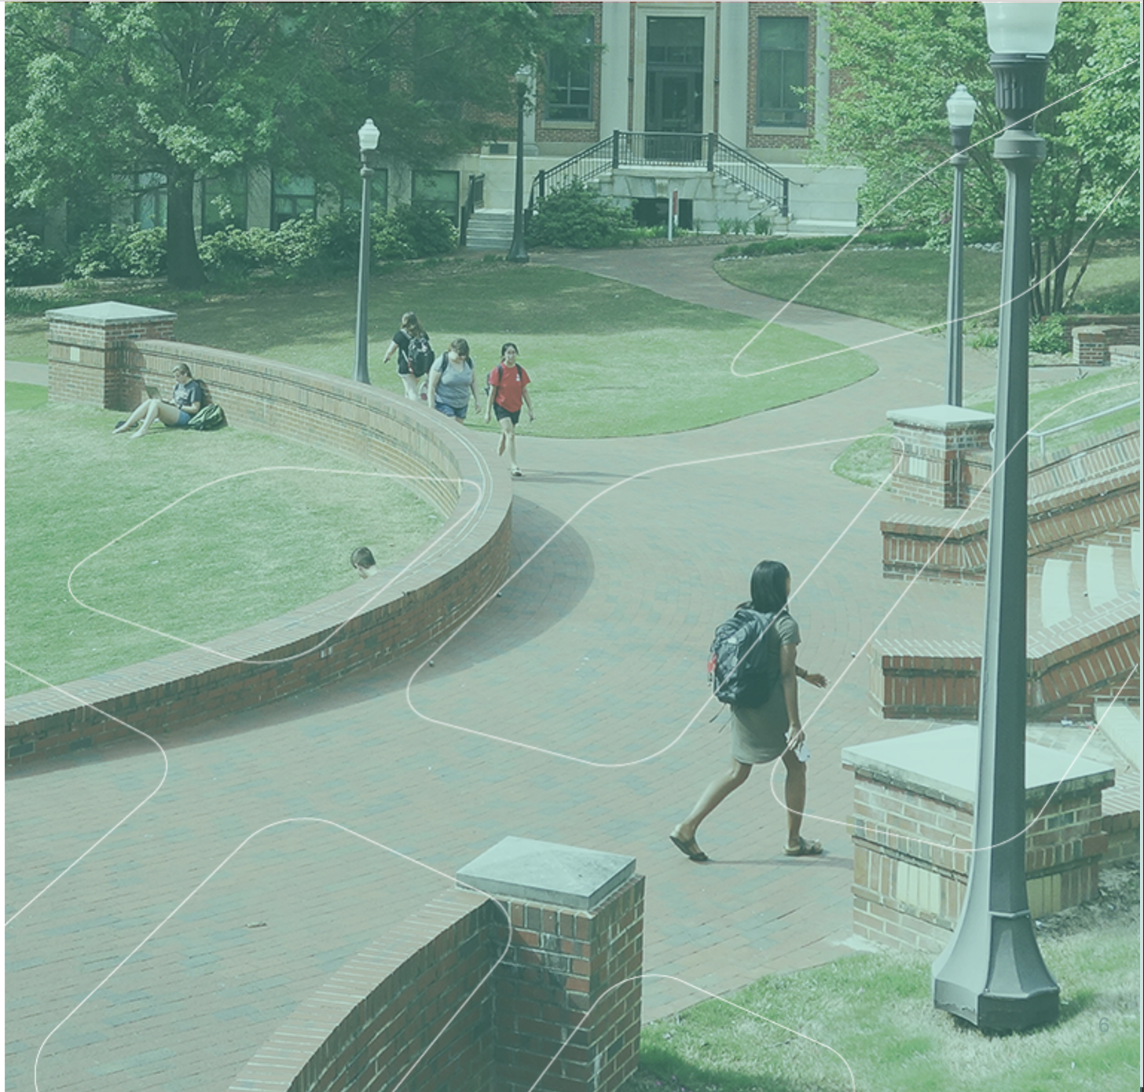
Sexual Assault Prevention for Graduate Students
Impact Snapshot
In order to make the content of this report easier to share with your colleagues and stakeholders, we have included a Snapshot section that highlights and visually displays the most salient data points from the full report.
This can help your data get more traction and increase interest in the full report and the Sexual Assault Prevention for Graduate Students program at large.
We recommend excerpting this Snapshot section from the full report and sharing with stakeholders, colleagues, and students who might be interested in the impact of the SAPG program but have less direct experience in prevention work.

Slide 7
Sexual Assault Prevention for Graduate Students: Snapshot
Georgia Institute of Technology
Designed by prevention and compliance experts to provide your students with knowledge and skills to support healthier campus communities.
Sample Size
Impact on Learners
Perceptions of Campus Climate
2,708 students
at Georgia Institute of Technology completed surveys in Sexual Assault Prevention for Graduate Students from June 1, 2024 to February 25, 2025.
Student perceptions of the commitment and intentions of their institution can have a significant impact on the feelings of safety, their experience on campus, and their likelihood to join the community effort to prevent abuse and harassment.
46% of students at Georgia Institute of Technology agree they can play a role in preventing sexual assault at your school.
Your students agree SAPG:
Helped me identify characteristics of healthy and unhealthy relationships. | 90%
Gave me information about sexual consent that I plan to use if I choose to be sexually active. | 89%
Provided me with skills to better support someone who has experienced sexual assault. | 90%
Note: Percentages represent students that responded “agree” or “strongly agree” to each item in the Post-Course Survey (n = 2,474).
Note: Percentages represent students that chose “agree” or “strongly agree” in the Follow-Up Survey (Part Two), n = 2,621.
Notes:
Assessment
|post_avg|
|pre_avg|
>>>>>>>>>>>
campusGraph
|your1|
|your2|
|your3|
|your4|
|your5|

Slide 8
Sexual Assault Prevention for Graduate Students: Snapshot
Georgia Institute of Technology
Preferred Bystander Behaviors
Bystander Intervention
Bystander Intervention Scenarios
Female
1 | Asking the person who you’re concerned about if they need help.
2 | Following up later to check in with the person who you were concerned about.
3 | Finding the friends of those involved and asking them for help.
Proactive bystander behaviors —stepping in directly or engaging other observers indirectly — are some of the most important ways students can support and build a healthy campus environment.
SAPG helps students build their bystander skills. Georgia Institute of Technology can use this information to continue to develop those skills as part of a healthy campus community.
Male
1 | Asking the person who you’re concerned about if they need help.
2 | Finding the friends of those involved and asking them for help.
3 | Creating a distraction to cause one or more of the people to disengage from the situation.
Tip
Research has shown that male students may be more likely to engage in active, direct bystander behaviors than their female peers. While it is encouraging to know that students are interested in stepping in to help peers, not every situation calls for a specific type of response. Students should be encouraged to engage in a wide range of behaviors and helped to understand which strategies should be employed for maximum effectiveness.​
Notes: The data in the graph and table are based on responses to the Follow-Up Survey (Part Two), n = 2,621.
88% of students at Georgia Institute of Technology agreed in the Post-Course Survey that SAPG made them more confident in their ability to intervene when they see concerning behavior.
Notes:
|Bystander1f|
|Bystander1m|
|Bystander2f|
|Bystander2m|
|Bystander3f|
|Bystander3m|
|Bystander4f|
|Bystander4m|

Slide 9
Georgia Institute of Technology
Impact Insights:
Sexual Assault Prevention for Graduate Students
Greatest Opportunities for Growth
Most students at my school would not engage in sexual activity with someone if the other person was incapacitated by alcohol or drugs. | 74%
Most students at my school would never place blame on a person who told them someone else had sexually assaulted them. | 82%
Most students at my school would take action in a situation in which someone was trying to take advantage of another person sexually. | 83%
Greatest Strengths
In a sexual situation, I would make sure to communicate with the other person about what they want. | 95%
I would respect a person who took action to prevent a sexual assault. | 95%
Clear, verbal, and sober permission is the best way to make sure a person is okay with sexual activity. | 94%
Items listed above represent the lowest-scoring survey items among your learners
Items listed above represent the highest-scoring survey items among your learners.
(n = 2,708)
(n = 2,474)
Note: Highest and lowest scoring items are taken from the Post-Course Survey (n = 2,474), and each percentage represents the learners at Georgia Institute of Technology that chose “Agree” or “Strongly agree” on a 5-point Likert scale.
Note: Learners at Georgia Institute of Technology demonstrated the most pre-to-post growth on these items upon completing this course.
9
Notes:
Impact
|gratestText1|
|gratestText2|
|gratestText3|
|IP1S1|
|IP1S2|
IP2S1|
|IP2S2|
|IP3S1|
|IP3S2|

Slide 10
SAPG and Your Students
Impact at Georgia Institute of Technology

Slide 11
Knowledge Gain
Georgia Institute of Technology
Assessments in SAPG, which students take before and after the course, are designed to measure their comprehension and knowledge of topics related to sexual assault.
Programming Tip
Where are your students knowledgeable and where is there room to learn more? SAPG is intended to provide foundational knowledge and skills that can be built upon. Knowledge data can inform which content areas should be built out or reinforced as part of your ongoing prevention efforts.
Notes:
|Gainpre1|
|Gainpost1|
|Gainpre2|
|Gainpost2|
|Gainpre3|
|Gainpost3|
|Gainpre4|
|Gainpost4|
|Gainpre5|
|Gainpost5|

Slide 12
Course Impact
Georgia Institute of Technology
After taking SAPG, students were asked to reflect on the course experience and tell us how the course impacted their awareness, knowledge, and skill in ways that will help them to make healthier decisions and support their peers in the future.
Your students reported that SAPG:
Made me more confident in my ability to intervene when I see concerning behavior. | 88%
Helped me identify characteristics of healthy and unhealthy relationships. | 90%
Taught me where to find resources for sexual assault and abusive relationships at my school. | 89%
Provided me with skills to better support someone who has experienced sexual assault. | 90%
Increased my understanding of school policies related to issues covered in the course. | 90%
Gave me information about sexual consent that I plan to use if I choose to be sexually active. | 89%
Programming Tip
How can you reinforce students’ skills and feelings of self-efficacy throughout the year and over your students’ college careers? Ongoing training — both annually online and through in-person opportunities such as workshops, role-playing, peer conversations — can reinforce key information, allow students to practice their skills, and build confidence.
Note: Percentages represent students that responded “agree” or “strongly agree” to each item in the Post-Course Survey (n = 2,474).

Slide 13
Healthy Relationships and Consent
Georgia Institute of Technology
In addition to developing knowledge, SAPG helps students build skills and attitudes they can use to support a healthy community. These include identifying unhealthy situations, supporting friends, and modeling attitudes that reflect healthy community norms.
(n = 2,708)
(n = 2,474)
Programming Tip :
Research has shown that young adults are likely to overestimate their own abilities, particularly when it comes to areas where they have not had to employ those skills. This leads to some students feeling overconfident in the Pre-Course Survey, but after taking the course, they may acquire a more nuanced perspective, which can help explain the flat or slight decrease in healthy responses pre-to-post course that you may see in the chart on this page.
Note: Percentages represent students that responded “agree" or "strongly agree” for each item.
Notes:
|HealthPre1|
|HealthPost1|
|HealthPre2|
|HealthPost2|
|HealthPre3|
|HealthPost3|
|HealthPre4|
|HealthPost4|

Slide 14
Supporting Survivors
Georgia Institute of Technology
Maintaining a healthy community requires supporting community members who experience sexual assault. SAPG covers: access to support and reporting resources, intervening in unhealthy situations and supporting others, and addressing attitudes of victim blaming when a sexual assault occurs.
(n = 2,708)
(n = 2,474)
Critical Processes Tip :
To learn more about what your colleagues are doing on their campuses, what is being shown to work in research, and to connect with others trying to prevent sexual assault and domestic violence in higher education, join the Campus Prevention Network at: https://www.vectorsolutions.com/industries/education/higher-education/campus-prevention-network/
Notes:
|SurvivorsPre1|
|SurvivorsPost1|
|SurvivorsPre2|
|SurvivorsPost2|
|SurvivorsPre3|
|SurvivorsPost3|
|SurvivorsPre4|
|SurvivorsPost4|
|SurvivorsPre5|
|SurvivorsPost5|

Slide 15
Sexual Assault Prevention On Your Campus
15

Slide 16
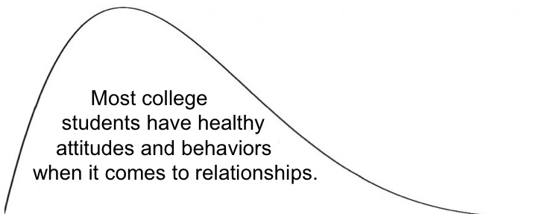
Engaging the Healthy Majority
Georgia Institute of Technology
SAPG data shows that most students have healthy attitudes and behaviors related to relationships. Although it is often tempting to focus on the relatively small group of “unhealthy” students, engaging the “healthy majority” can create a culture of care and accountability that helps build a safe community.
In addition to reporting on the personal experiences of your students, the following pages highlight topics that can help you understand how to engage and bolster the healthy majority on your campus: bystander intervention, social norms, perceptions of campus climate, and readiness to engage in prevention efforts on your campus.
Most college
students have healthy
attitudes and behaviors
when it comes to relationships.
Healthy Attitudes and Behaviors
Unhealthy Attitudes and Behaviors
Critical Processes Tip
Reflect on the share of your sexual assault prevention programming and policies that is focused on supporting the healthy majority, compared to addressing or disciplining the unhealthy minority. Are there areas where you could supplement or expand efforts that develop a positive culture on your campus?

Slide 17
Personal Experiences, Females and Males
Georgia Institute of Technology
Some of your students will arrive on campus with personal experience with sexual assault, relationship violence, or stalking. Others may have these experiences after they become members of your community.
 | Female |  | Male
 | Before | After | Before | After
Sexual Assault | 15.82% | 2.04% | 5.32% | 1.05%
Relationship Violence | 9.38% | 1.39% | 4.76% | 0.63%
Stalking | 16.98% | 2.66% | 5.17% | 0.91%
Sexual Assault
In the past, someone pressured or forced me into sexual contact without my explicit consent.
Relationship Violence
I have experienced some form of abuse or threats of abuse in a current or previous relationship.
Stalking
In the past, I have experienced repeated and unwanted attention, harassment, or other contact from another person that has made me feel afraid.
Before = Percentage (%) of respondents who reported “Yes, before coming to campus” OR “Yes, before and after coming to campus”
After = Percentage (%) of respondents who reported “Yes, after coming to campus” OR “Yes, before and after coming to campus”
Note: Based on responses to the Follow-Up Survey (Part Two), n = 2,621.
Critical Processes Tip
Notice how personal experiences may be different for male and female students. Think about what other demographic characteristics may have an influence on personal experiences at your institution, including race/ethnicity, group membership, year in school, age, etc.

Slide 18
Bystander Behaviors, Females
Georgia Institute of Technology
Understanding how your students prefer to stand up for one another can help you develop strategies to reinforce those strengths, and to help students feel more supported when they do stand up. Below are the preferred bystander behaviors for female students on your campus.
Bystander Intervention Scenario
I spoke up when I heard someone saying something I found offensive or demeaning. | 94%
I expressed concern when I saw a person exhibiting abusive behavior toward their partner. | 97%
I helped someone get support or find resources when they told me about an unwanted sexual experience. | 94%
I intervened when I saw someone trying to take advantage of someone else sexually. | 95%
Note: Percentages are of students who indicated they have been present in the described scenario.
Programming Tip
Given that students with different identities report different experiences, attitudes, and behaviors, it is important to consider additional resources that may be directed towards specific student populations on campus. These efforts may focus on high-risk student sub-groups, and we also suggest using targeted supplemental education and resources to help all students feel safe and welcome on campus.
Preferred Bystander Behaviors
Your female students tend to express confidence in engaging in the following three behaviors if they observe a potential sexual assault situation:
Asking the person who you’re concerned about if they need help.
Following up later to check in with the person who you were concerned about.
Finding the friends of those involved and asking them for help.
Note: All data shown on this slide are based on responses to the Follow-Up Survey (Part Two), n = 2,621.

Slide 19
Bystander Behaviors, Males
Georgia Institute of Technology
Proactive bystander behaviors — stepping in directly or engaging other observers indirectly — are some of the most important ways students can support and build a healthy campus environment. On the right is a summary of when male students on your campus have intervened, and their preferred strategies for doing so.
Bystander Intervention Scenario
I spoke up when I heard someone saying something I found offensive or demeaning. | 94%
I expressed concern when I saw a person exhibiting abusive behavior toward their partner. | 97%
I helped someone get support or find resources when they told me about an unwanted sexual experience. | 96%
I intervened when I saw someone trying to take advantage of someone else sexually. | 96%
Note: Percentages represent students who indicated they had been present in the described scenario.
Programming Tip
Research has shown that male students may be more likely to engage in active, direct bystander behaviors than their female peers. While it is encouraging to know that students are interested in stepping in to help peers, not every situation calls for a specific type of response. Students should be encouraged to engage in a wide range of behaviors and helped to understand which strategies should be employed for maximum effectiveness.​
Preferred Bystander Behaviors
Your male students tend to express confidence in engaging in the following three behaviors if they observe a potential sexual assault situation:
Asking the person who you’re concerned about if they need help.
Finding the friends of those involved and asking them for help.
Creating a distraction to cause one or more of the people to disengage from the situation.
Note: All data shown on this slide are based on responses to the Follow-Up Survey (Part Two), n = 2,621.

Slide 20
Social Norms for Behavior
Georgia Institute of Technology
Norms Gap, Before Course
20 points
22 points
17 points
30 points
14 points
An individual is more likely to act in a particular way if they believe their actions will be supported by their peers. However, research shows that there is often a gap between what an individual thinks they would do (the “actual norm”), and what they believe their peers would do (the “perceived norm”). This is called the ”norms gap.” SAPG aims to decrease the norms gap among your students so they’ll be more likely to engage in positive behaviors on campus.
Norms Gap, After Course
10 points
11 points
10 points
17 points
10 points
Programming Tip
Feelings of not being supported by other members of a social group or community are likely to be an obstacle to intervening, standing up to concerning behavior, and supporting friends and peers. You can examine the norms gap between subgroups by requesting raw data extracts and looking into which groups could use additional training and support to close the norms gap.
Notes:
BeforeCourse
|Actual1|
|Peer1|
|Actual2|
|Peer2|
|Actual3|
|Peer3|
|Actual4|
|Peer4|
|Actual5|
|Peer5|
>>>>>>>>>>>>
AfterCourse
|Actual6|
|Peer6|
|Actual7|
|Peer7|
|Actual8|
|Peer8|
|Actual9|
|Peer9|
|Actual10|
|Peer10|

Slide 21
Campus Climate
Georgia Institute of Technology
After completing the course, students answered a series of questions related to the climate around sexual assault at their school. This information can help you understand the degree to which your institution’s sexual assault prevention efforts are impacting student perceptions of the campus environment.
Institutionalization Tip
Students’ perceptions of the commitment and intentions of their institution can have a significant impact on their feelings of safety and support, their experience while on campus, and their likelihood to join the community effort to prevent abuse and harassment. These may be very valuable data points to share with administrators to show how students are feeling about the climate at your institution and for senior leaders to consider when communicating publicly about the expectations of students in their community.
Note: Percentages represent students that chose “agree” or “strongly agree” in the Follow-Up Survey (Part Two), n = 2,621.
Notes:
|campuspre1|
|campuspost1|
|campuspre2|
|campuspost2|
|campuspre3|
|campuspost3|
|campuspre4|
|campuspost4|
|campuspre5|
|campuspost5|

Slide 22
Community Readiness
Georgia Institute of Technology
After completing the course, students answered questions about their readiness to address sexual assault at their school — from identifying sexual assault as an issue worthy of their attention, to getting personally involved in prevention efforts.
Programming Tip
These categories from left to right represent a continuum of readiness to support prevention efforts on your campus. While most students come to school with a healthy and open mindset, it is important to consider how prevention efforts are influencing all students across this continuum and how we can pull those from the least desirable categories towards a more positive perspective towards community at your institution.
Notes: Based on responses to the Post-Course Survey (n = 2,474).
Notes:
|CommunityPre1|
|CommunityPost1|
|CommunityPre2|
|CommunityPost2|
|CommunityPre3|
|CommunityPost3|
|CommunityPre4|
|CommunityPost4|
|CommunityPre5|
|CommunityPost5|

Slide 23
Sexual Assault Prevention for Graduate Students
Appendix | Student Demographics
23

Slide 24
Student Demographics
Georgia Institute of Technology
The following is a summary of the demographics of students who completed surveys in SAPG from June 1, 2024 to February 25, 2025. Demographic information is self-reported by students as part of the Pre-Course Survey (n = 2,708). All questions are optional, and students may choose not to share demographic information.
 | Male | 64% |  | Female | 36%
 | Other | 1%
 | Heterosexual/Straight | 82% |  | Bisexual | 9%
 | Gay | 3% |  | Lesbian | 1%
 | Questioning | 1% |  | Other responses | 8%
Note: ‘Other responses’ reflects the number of students who selected Asexual or Queer
Note: Both of these questions allow respondents to select more than one item, so either total may exceed 100%.
Notes:
GenderIdentity
|male|
|fem|
|other|
>>>>>>>>>>
SexualOrientation
|het|
|bis|
|gay|
|les|
|ques|
|otr|

Slide 25
Student Demographics (continued)
Georgia Institute of Technology
 | First year | 97% |  | Fifth year | 0%
 | Second year | 1% |  | Sixth year | 0%
 | Third year | 0% |  | Other | 0%
 | Fourth year | 0%
Note: Respondents could choose more than one option, so total may exceed 100%.
Notes:
Race
|race1|
|race2|
|race3|
|race4|
|race5|
|race6|
Age
|utw|
|twf|
|twn|
|thf|
|thn|
|fof|
|off|

Slide 26
Sexual Assault Prevention for Graduate Students
Supplemental Information
26

Slide 27
The Prevention Framework
Programming
Prevention training, programs and, communication strategies that maximize engagement and drive impact
The Prevention Framework, developed by Vector Solutions’ Campus Prevention Network, defines the elements of a comprehensive approach to prevention, and the ways in which those elements build to an effective prevention program.
Policy
The values and expectations of the institution, and the-system of
accountability to uphold and enforce them
Critical Processes
Using goal setting, strategic planning, and data analysis to inform and evaluate prevention work
Institutionalization
System-wide buy-in, visible commitment, and investment in effective prevention initiatives
27

Slide 28
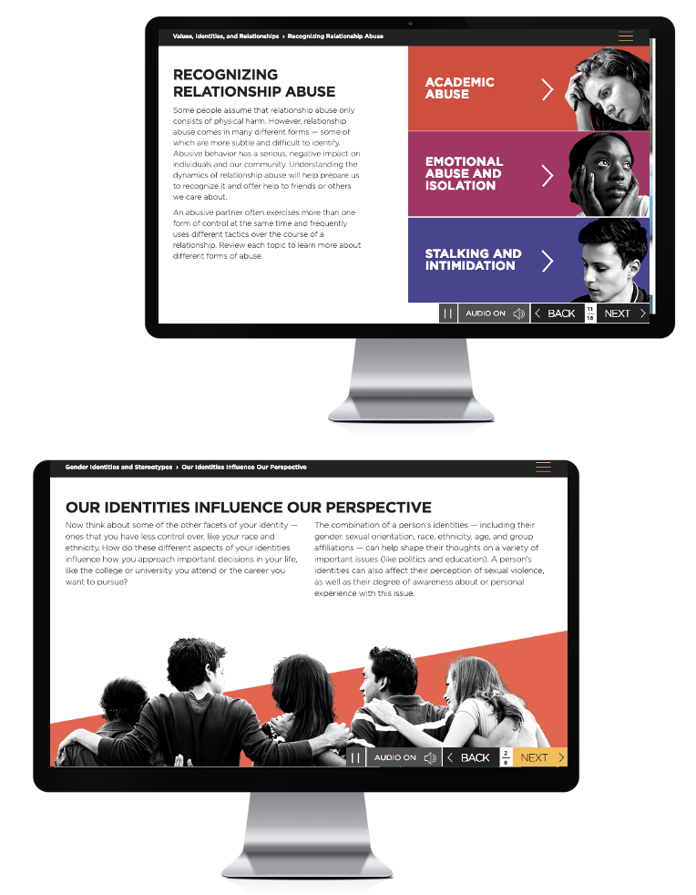
About Sexual Assault Prevention for Graduate Students
The Benefits of Working with Vector
Sexual Assault Prevention for
Graduate Students
Proven Efficacy
Nine independent published studies demonstrate the efficacy of Vector Solutions’ online programs. Our approach improves knowledge, attitudes, and behaviors.
Helps meet or exceed
Title IX and Clery Act requirements.
True Expertise
Our team includes experienced public health professionals, student affairs administrators, prevention experts, and legal authorities. Extend your team by partnering with ours.
Developed in collaboration
with leading prevention experts and researchers.
Beyond Compliance
Our online programs are built by prevention and compliance experts to meet and exceed requirements from Title IX, Clery Act, and EDGAR part 86.
Informed by Emerging Research
on evidence-based practice (e.g., social norms approach, bystander intervention).
Data Driven
Our data and analytics platform provides real-time access to attitude and behavior data from each of your unique populations and allows you to benchmark against select peer groups.
Shown to have impact
on student attitudes and intentions at a campus-level in peer-reviewed publication.
Notes:
Increased font size in the table and realigned

