Slide 1
SEWB Strategic Plan Guideline

Slide 2


SEWB Unit Planning, Assessment, & Reporting
It is part of SACSCOC Accreditation & good business practice.
2
An annual/on-going process by which units set, measure, implement, and assess goals.
3
Must be in-line with Institute Strategic Plan (ISP) or President’s Goals (PG).
4
Required for most units: Strategic Assessment Plans (SPA), End-of-Year (EOY), Progress Check-Ins & Reporting.
5
Annual unit reports due on October 1st each year to document goal attainment & accomplishments.
6
Basic Standards for reporting and all SEWB reports due in the Anthology Planning platform
Notes:
Southern Association of Colleges and Schools Commission on Colleges

Slide 3
Units Required to Submit Reports
Arts, Belonging &
Community
SEWB
Vice President
Campus Services
Student Life
Intercultural Student Programs
Office of the Arts
Student & Campus Event Center
Veteran’s Resource Center
Campus Recreation Center
Campus Services Administration
Card Services & Credentialing
Auxiliary Operations
Tech Dining
Housing & Residence Life
Stamps Health Services
Sustainability
Center for Mental Health Care & Resources
Center for Student Engagement
Dean of Students
Leadership Education & Development
Orientation & Transition Programs
Student Integrity
Wellness Empowerment Center
Cultivate Well-Being Action & Transformation
Development and Parent Giving
Marketing & Communications
End-Of-Year Report Only
Budget & Finance, Business Operations, Capital Projects, Engagement and Human Resources/Business Partners.

Slide 4
Strategic Plan Assessment Timeline
Progress Check-In
Progress Check-In
Progress Check-In
July
August
Sept
Oct
Nov
Dec
Jan
Feb
March
April
May
June
Unit Strategic Plan REPORT & EOY
Due October 1st
Unit Strategic PLAN
April 1st
FY Ends June 30th
FY Begins July 1st
ISP Status Update Due
July 1st
ISP Status Update Due
January 8th
PG Update #1
PG Update #2
ISP Status Update Due
April 1st
PG Final Update Due
May 1st
PG= Presidential Goals
ISP= Institute Strategic Plan

Slide 5

Strategic Plan Assessment – Goal(s)

Slide 6
Strategic Plan Assessment (SPA) – Plan and Report
Plan
Continuous Improvement
Goals
Resources
Goals
High-level statement of what your unit aims to accomplish in alignment with its mission.
Resources needed to accomplish the objective.
Implementation & Timeline
Objective
It involves transforming the strategic vision into actionable steps and processes.
Results
Objective
Concrete targets that are established to guide the direction and performance of your unit.
Measure
Report
Quantifiable metric used to evaluate success in achieving your unit's strategic objectives.
Results
Implementation
&
Timeline
It refers to the tangible outcomes or achievements that an organization or entity has realized over a defined period.
Measure
Benchmark
Performance target that refers to a specific standard your unit strives to meet.
Continuous Improvement
Action Item
It describes how assessment findings will be utilized to drive ongoing improvement in the department.
Resources
Benchmark
Discrete task that must be accomplished by a specific deadline as part of a larger project.
Action Item

Slide 7
Goal Standards
1-3 annual goals per unit - goal(s) and/or objectives should be in S.M.A.R.T. framework
01
Each goal should link to the strategic priority of the Institute Strategic Plan
02
Each Goal can have multiple objectives/tactics
03
Defined measures of success for each goal
04

Slide 8
Goals, Objectives, Strategies, and Metrics
Goals | Objectives | Strategies | Metrics
High-level, overarching descriptions of the results we aim to accomplish. A plan can have multiple goals | Describes the specific, measurable expected outcomes we will work to achieve the goal. Goals can have multiple objectives | Action-oriented efforts to pursue the expected outcome described in the objectives. Objectives can have multiple strategies | Quantitative or qualitative indicators to assess and communicate our progress as we implement the plan. Objectives can have multiple metrics
Example (from the Institute plan): To embrace our power as agents of change for the public good and generate talent, ideas, and solutions with unmatched impact and scale to help define and address the most critical problems of our time, locally and globally | Example (from the Institute plan): Provide all students with transformative learning experiences to grow as creative, ethical, globally aware, technologically sophisticated leaders who can define and solve problems to improve the human condition. | Example (from the Institute plan): Make experiential, problem-based service-learning a signature of all academic and research programs. | Example (from the Institute plan): Number of students who complete a cross-disciplinary pathway and participate in a transformative experiential, problem-based, or service-learning experience.
Goal 1: | Objective 1: | Strategy 1: | Metrics 1:
 |  | Strategy 2: | Metrics 2:
 | Objective 2: | Strategy 1: | Metrics 1:
 |  | Strategy 2: | Metrics 2:
 | Objective 3: | Strategy 1: | Metrics 1:
 |  | Strategy 2: | Metrics 2:
 |  | Strategy 3: | Metrics 3:

Slide 9

Strategic Plan Items - Mission Statement
The mission statement is a brief description of the unit's fundamental purpose. It answers the question, 'Why do we exist?' The mission statement articulates the unit's objectives and its approach to achieving those objectives. It serves as a guide for decision-making processes and helps ensure that they align with the institute's values and ethos. The statement includes the unit's purpose, core values, target audience, and services offered.
“The Georgia Institute of Technology is a public research university established by the state of Georgia in Atlanta in 1885 and committed to developing leaders who advance technology and improve the human condition”.

Slide 10

Strategic Plan Items - Department Goal
Department goal is a high-level statement of what your department aims to accomplish in alignment with its mission.
Each department is expected to have one or two goals.
Goals remains stable over a 3-5-year period.
Please indicate the department goal number in the Department Goal # field.
Select the department goal’s relationship with the Institute’s strategic plan from the dropdown list.

Slide 11

Strategic Plan Items - Objectives
Objectives are concrete targets that are established to guide the direction and performance of your unit.
They outline the “how” and “what” needs to be done to move toward fulfilling the organization’s mission and vision.
They should be specific, measurable, achievable, relevant, and time-bound (S.M.A.R.T.).
Please use the #.# format to link each objective to the corresponding department goal (e.g., 1.2 indicates that the second objective is associated with department goal 1).

Slide 12
S.M.A.R.T. Format for Objectives
Specific
They clearly define what is to be achieved
Measurable
They have associated criteria that allow for tracking progress and outcomes
Achievable
They are realistic and attainable within the available resources and time frame
Relevant
They align with the organization’s strategic direction and its long-term goals
Time-Bound
They have a clear deadline by which the goal should be met

Slide 13
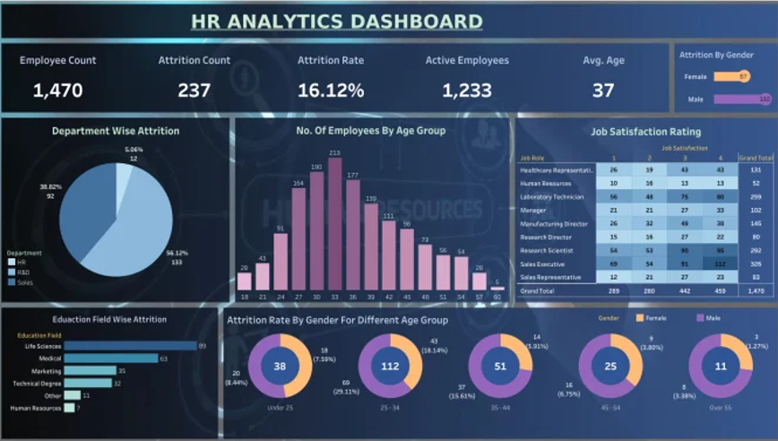

Strategic Plan Items - Measure and Benchmark
In a strategic plan, a measure is a quantifiable metric used to evaluate an organization's success in achieving its strategic objectives. Measures are crucial for tracking progress, assessing effectiveness, and guiding informed decision-making. They provide evidence of whether the strategy is working and help determine if adjustments are needed.
A benchmark as a performance target refers to a specific standard or set of standards that an organization strives to meet or surpass. This target is typically based on industry best practices, competitor performance, or an internally recognized level of excellence. Benchmarks are used to measure progress and drive continuous performance improvements.

Slide 14

Examples of Objectives and Measures
Measure 1: Engage X number of students in community services each year
Objective: Expand Community Engagement
Measure 2: Increase partnerships with local organizations by X%
Measure 1: Achieve X% increase in the enrollment of underrepresented student groups by year Z
Objective: Advance Diversity and Inclusion
Measure 2: Implement X number of diversity and inclusion training programs for faculty and staff
Measure 1: Complete X number of campus improvement projects by year Z
Objective: Improve Infrastructure
Measure 2: Increase classroom and laboratory space by X square feet by year Z
Measure 1: Launch X new interdisciplinary degree programs by year Z
Objective: Develop Innovative Programs
Measure 2: Secure X amount of funding for curriculum development

Slide 15
Strategic Plan Items - Action Item and Resources
Action Item
An action item is a discrete task that must be accomplished by a specific deadline as part of a larger project, meeting, or plan. It is an actionable step assigned to an individual or team to complete to achieve a particular goal or objective. Use this space to describe specific activities, projects, or initiatives the department will implement to achieve the objective and reach the benchmark.
Resources Needed
Please, use the dropdown list to select if your unit will need resources to achieve the objectives described before. If your department will need resources, please use the appropriate space to describe those resource needs (e.g., $2500 to purchase software, $1000 for training, etc.).

Slide 16


Strategic Plan Items - Implementation and Timeline
Implementation involves transforming the strategic vision into actionable steps and processes. Please describe the specific steps that will be taken to achieve the defined goals, along with the schedule or timeframe within which the implementation of the strategies and activities is expected to occur.
STEP 1
2022
STEP 3
2024
STEP 5
2021
2023
2025
STEP 2
STEP 4

Slide 17

Strategic Plan Items - Actual Results
Actual results typically refer to the tangible outcomes or achievements that an organization or entity has realized over a defined period, such as a fiscal year or a specific project timeline. These results are compared against the goals, objectives, and targets set forth in the strategic plan.
Please use the space to provide a brief narrative of the specific results for each measure. The narrative should include, where appropriate, the specific percentage or sample size that aligns with the target for performance.

Slide 18
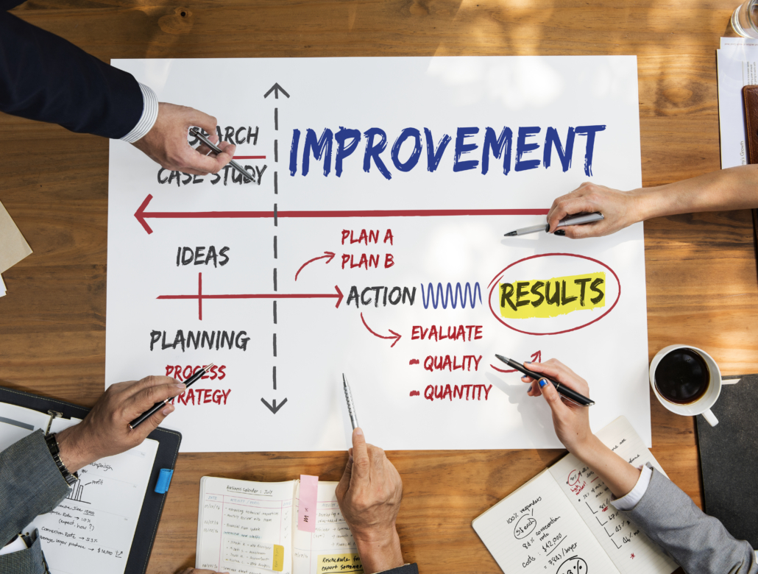
Strategic Plan Items - Use of Results for Continuous Improvement
Please use this space to describe how assessment findings will be utilized to drive ongoing improvement in the department. This includes analyzing assessment results, identifying areas for improvement, and implementing strategic changes and actions based on the insights gained from the assessment. The aim is to continuously enhance performance, effectiveness, and efficiency by utilizing assessment data to inform decision-making, refine processes, and address identified areas of improvement.

Slide 19


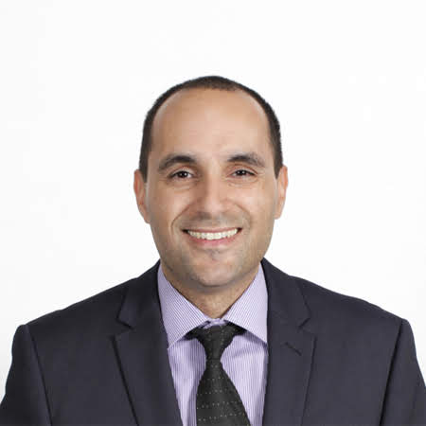
Questions
Dr. Brenda “B” Woods
Office of Research and Assessment
Director
drbwoods@gatech.edu
Rafael Soares
Office of Research and Assessment
Senior Business Analyst
rsoares30@gatech.edu

